Slide 1







How to manage BIG feelings: Building emotional
resilience to support learning in school

Slide 2

Outline for today’s session:
Introduction: Dr. Sarah Hatfield, Assistant Principal Psychologist, EPSS and Harriet Tunnicliff, Adviser, Virtual School for Children in Care, Previously in Care and Children with a Social Worker
Introducing DESTY (Discovering Exceptional Strengths and Talents in You) – Founder and Educational Psychologist Stephanie Fitzgerald – How can it be used to create more connected, resilient and engaged learners?
We welcome Wensum Junior School SEMH Base and Cringleford Primary School
Q&A (if time allows)
Notes:
Sarah to lead welcome and introduce Sarah, introduce Harriet and overview of today’s session

Slide 3



Desty in Norfolk so far…
2022/23 – Pilot project jointly funded with Early Intervention and Prevention Team and Virtual School
Opportunity to participate in ‘An Evaluation of a Cross Authority Collaboration in Building Children’s Emotional Resilience’
2023/24 – Applications to train Desty Mentors have been made through the Trauma and Attachment Aware Practice in School training grant through the Virtual School
2024/25 – Partnership with EPSS and Virtual School and opportunity for schools to access Desty Mentor Training through Virtual School Trauma and Attachment Aware Practice offer.
Notes:
Harriet to explain work with Desty so far and then introduce Stephanie: Pilot project - 50 Level 2 school-based Desty Mentors and 30 Level 1 Practitioners in Social Care (Cross Authority Collaboration project). Core themes that arose from the evaluation was the opportunity for participants to gain a deeper understanding of the impact of brain development on behaviour, gain knowledge and skills to support emotional regulation in children,

Slide 4


Stephanie O’Malley
Founder/ Educational Psychologist
Developing Children’s Emotional Resilience with DESTY

Slide 5
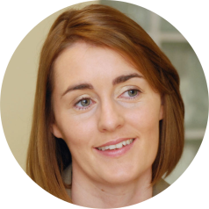

Introduction:
Stephanie O’Malley BA(Psych) MA(Ed Psych)
FOUNDER & EDUCATIONAL PSYCHOLOGIST
Working as Ed Psych over 14 years
Children in care
Children with additional learning needs (ASD, ADHD, Intellectual Disability etc)
Children with complex medical needs
Children with trauma and attachment related needs
Children with Social, Emotional and Mental Health Challenges
(SEMH)

Slide 6

Children that kept me awake at night:
Those that displayed ‘challenging behaviour’

Slide 7

Those that shut down due to trauma and ‘attachment issues’

Slide 8
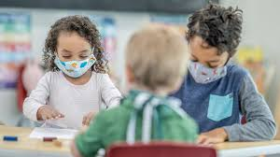
Children Impacted by Covid-10 Policies and Restrictions

Slide 9
Impact:
Children disengaged from learning
Poorer educational outcomes
Created stress in school and home environment
Burnout of parents, carers, support staff
Breakdown of care placements
School exclusion

Slide 10

Network Around the Child

Slide 11


DESTY MENTOR

Slide 12
How do we empower the ‘good adult’ in the child’s life?

Slide 13
Provide a framework & support structure:
Training (Online certified self-paced training, Live mentor workshops, 1.5 hours/8 weeks)
DESTY Mentor Network of support
Practical tools & ideas

Slide 14
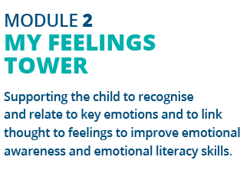
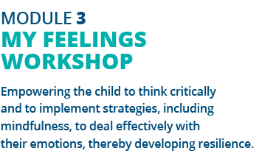
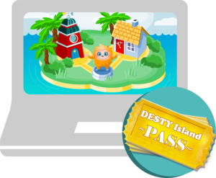
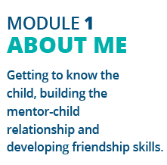
The Journey through DESTY Island

Slide 15
DESTY ISLAND FEATURES:
CHILD-CENTRED, CHILD-PACED
ATTACHMENT-BASED
PERSONALISED
INDIVIDUAL REPORTING
IMPACT ASSESSMENT (SDQ)
MOVES WITH THE CHILD
35 MINUTES AT LEAST ONCE PER WEEK

Slide 16
IMPACT – More connected, resilient and engaged learners.
Feedback from mentors:
Improves attendance in school
Decrease in suspension rates
Improves participation in learning
Improves relationship skills
Improvements in emotional regulation skills
Increases self-confidence and self-esteem

Slide 17

DESTY at Wensum Junior
Corrina Peachment, Headteacher and Kelly Butler-Dack, Teaching Assistant
Notes:
Sarah to introduce and lead Wensum Junior Presentation

Slide 18
DESTY at Wensum Junior…
WHY?
More children are struggling with their mental health and well-being.
Mainstream school with SRB for children with SEMH needs.
DESTY was recommended by the EP team to support our children.
Recognised need to address emotions and behaviour, particularly for these children.
Supports the need to build positive, safe, secure relationships between children and adults.
Invaluable 1:1 time.
Supports other curriculum areas, especially PSHE
Understanding emotions and regulation will benefit the whole child and enable them to be successful.
External support and services are available but usually have long waiting lists – DESTY in school = immediate support.
Anticipated Impact
Successful programme due to the design and delivery – age appropriate and screen based. Will appeal to children.
Exciting – creating their own Avatar
Joined up approach – can be used by adults in school and parents at home.
Engaging
Positive impact on the child’s self-confidence and self- esteem.
Resulting in more successes at school.
Resulting in improved attainment and progress.
Better long-term outcomes.
Hopes to move this into the main school to support children.
Children will come away able to identify their emotions, helping them to self regulate when needed.

Slide 19
DESTY to me
Simple to follow but extremely informative
Better understanding of the body/brain
Insight to helping/understanding the children
Personalized to meet the children where they are comfortable- on a device
Important connections for the children
Necessity for our SRB unit

Slide 20
My DESTY Experience
Simple and straight forward to follow
Self paced units lead to better work/life balance, lifting pressure
Bitesize units, breaking things down so it’s easier to digest
Recap quizzes to show you’ve taken the information in
Really informative information, keen to learn more and continue
Would absolutely recommend

Slide 21
Implementing Desty in School
We’re pleased to welcome Rachel Bradshaw, Deputy Headteacher and Sabina Spence, Teaching Assistant and Desty Mentor from Cringleford CE VA Primary School.
Notes:
Harriet to lead questions with reflections from Sarah and Stephanie
Can you talk to us about the profile of pupils who you have identified to access Desty within your school?
Pupil premium identified
Presenting behaviours (emotional outbursts)
Need to develop emotional literacy
Case study shared of a forces child and anxiety when parent is deployed
Can you share some of the key ways you have prepared to implement and deliver Desty as an intervention?
Protecting Sabina’s time to deliver
Space to deliver sessions
Careful consideration of who to use licences with
Creating an environment to deliver Desty: music playing, exercise balls to sit on while engaging in Desty, use of bean bags, Sabina uses her existing knowledge or pupils to build in an opportunity to connect with them at the start of each session
Can you share your reflections on the training, Sabina, and also reflections of putting this in to practice for both yourself delivering the training and Rachel in ensuring this links to other key areas across the school?
Sabina shared that training was well-paced and enjoyed the combination of training as well as live webinars
In putting Desty in to practice, you have felt confident enough to adjust session length expectations to adapt to the needs of a child being supported by Desty so that they can access this in a meaningful way
With Desty Island being a computer programme, sitting side by side felt this to be supportive as both child and adult focus is on the creation and exploration on the screen.
Rachel we spoke about how this is linked to SEND provision as pupils accessing are yes to assess/EAL
What was an unintended consequence of delivering Desty?
You spoke about for one pupil attending the intervention had created a relationship with Sabine and this could be seen in their behaviour around school with other opportunities to connect with Sabine such as the lunch times. The intervention has meant Sabine is a trusted adult for this child and has ensured that her emotional availability, connection and noticing of this pupil goes beyond their Desty sessions which has had a noticed impact.
What are pupil views of Desty?
Sabine you were going to check in with the children that your working with to see what they’ve said and I believe you mentioned a parent feeding back also.
What are your future considerations for continuing with Desty?
Bring the above experience of implementing Desty in to discussions with class teachers
Link this to the mental health lead role in school
Use learning from this first group to narrow down the profile of pupil who this will benefit – specifically considering those who may not be displaying BIG behaviours and may be go unnoticed
Rachel we spoke about it addressing the lower level profile of need – supportive in being able to offer parents something when they are concerned and preventing those concerns/needs escalating to SEN support, EHCP etc. One particular parent has felt heard and held by raising a concern and then DESTY being used and have a positive impact. Both parent and child seem more regulated and less anxious.
Rachel we also spoken about how Desty aligns to the wider context of the school and approaches to behaviour. The school is on a journey towards being trauma informed, DESTY has been a supportive small step in providing some direct support for a small group and good CPD for Sabina
More widely the school has booked in the Virtual School Trauma and Attachment Training in September
The school is also reflective of the high numbers of Previously in Care children on role and the particular profile of needs they may present within in terms of trauma
Open to Sarah and Stephanie for closing comments.

