Slide 1







The power of ‘ordinary magic’:
the impact of trauma informed practice building relationships and resilience in schools

Slide 2
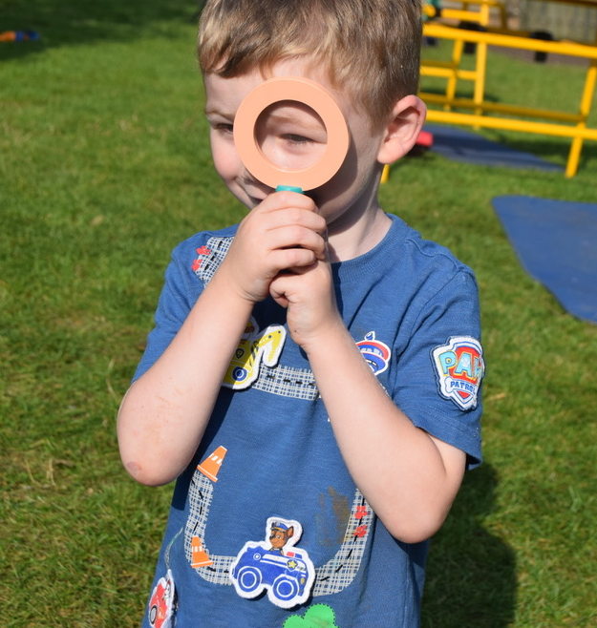

Look after yourself

Slide 3
Outcomes from today’s session:
What is resilience?
What makes a difference for children whose lives are threatened by disadvantage or adversity?
How can trauma informed practice in schools support relationships that positively impact outcomes for children?
Speakers joining us today:
Christine Davis, Trauma Informed Schools UK
Stacey Bramley, Ashleigh Primary School
Laura Bay, Virtual School
Jamila Thompson, Youth Support Worker, Targeted Youth Support Service
Neil Moggan, Future Action

Slide 4
What is resilience?
Resilience is the process of adapting well in the face of adversity, trauma or stress.
Resilience is not a special quality located within a child or young person. It is something that emerges though a child or young person’s interaction with others - at home, at school and in their communities.
What is resilience? : Mentally Healthy Schools

Slide 5
Why understand resilience?
We also know that certain harmful experiences in childhood (known as Adverse Childhood Experiences – ACEs) can be toxic to children and young people’s development, resulting in hidden trauma and potentially leading to later mental health problems. These adverse childhood experiences include:
neglect and abuse – including sexual abuse
violence between parents/carers
parental separation
poor parental/carer mental health
parental substance/alcohol misuse
What is resilience? : Mentally Healthy Schools
Known RISK FACTORS to child development:
Low birth weight
Low Socioeconomic status – less access to financial, educational, social and health resources
Family Violence
Divorce
Harsh or neglectful parenting
Natural Disasters
Terrorism
Malnutrition
Poverty
Homelessness or other forms of family displacement
(this list is not exhaustive, Masten:2014)

Slide 6



Understanding what can influence and impact a child’s development
Law and Policies
Culture
Neighbourhood
School
Family
Child
Based on Urie Bronfenbrenner’s Ecological Systems Theory

Slide 7

Think of a child
Think of a child or adult you know well who has shown resilience.
Question: What made a difference in this person’s life and made it possible for them to overcome adversity?
Type your answers in to the chat function.
Please do not identify the person you are thinking of.
Effective caregiving and parenting quality from parent/carer/ guardian | Close relationships with other capable adults | Close friends or romantic partners | Intelligence and problem-solving skills | Self-control and emotional regulation
Motivation to succeed | Self-efficacy | Faith, hope, belief that life has a meaning | Effective Schools | Effective communities
Table adapted from ‘The “Short List” of Widely Reported Factors Associated with Resilience in Young People and Implicated Adaptive Systems’ Masten,2014

Slide 8
What makes a difference for children whose lives are threatened by disadvantage or adversity?
Resilience comes from “ordinary magic”, and it is possible to understand where it comes from and how to foster it. – Masten, 2014
“- what the researcher Professor Ann Masten calls ‘ordinary magic’, which includes having good relationships with parents and carers, a sense of belonging at school and feeling like there are people in your life that you can trust. Taken in combination, this can give young people a sense of safety and confidence.” Dr Jess Deighton, Head of the Evidence Based Practice Unit at Anna Freud and lead on the Headstart learning programme.
The HeadStart Learning Programme | Anna Freud

Slide 9
Why this really matters….
" At their best, schools can function as islands of safety in a chaotic world. They can teach children how their bodies work and how they can understand and deal with emotions. Schools can play a significant role in instilling the resilience necessary to deal with the trauma of neighbourhood or families"
Van De Kolk, 2015, P.351

Slide 10
Case study key themes to be shared today:
Relationships built with caring adults both in school and in supporting young people in education, employment and training post-16.
Supporting emotional self- regulation in school
Creating opportunities to succeed, develop self-belief and have positive interactions in school

Slide 11
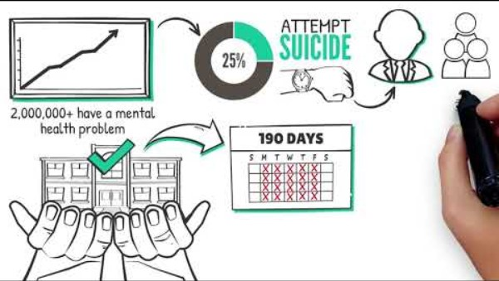
Video

Slide 12
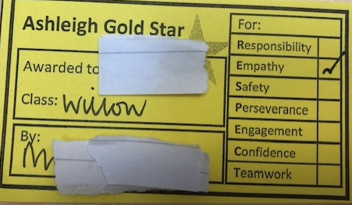
Ashleigh Primary School and Nursery, Stacey Bramley, Parent Support Adviser
Whole School approaches
Protect: To ensure safety first | Meet & greets Safety cues: being mindful and briefing session for staff Providing staff with relevant information Lunchtime alternative space Support staff with challenging situations PACE (Playfulness, Acceptance, Curiosity, Empathy)
Relate: Form meaningful relationships | Familiar face around the school Greet children when passing and show interest Build relationships with children We celebrate achievements
What is meant by PACE? - DDP Network

Slide 13
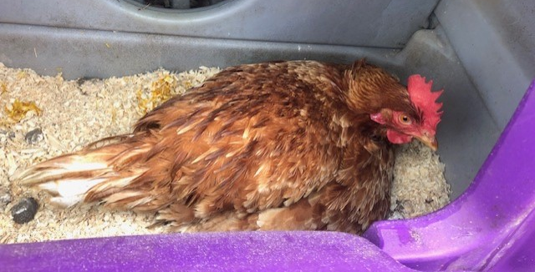
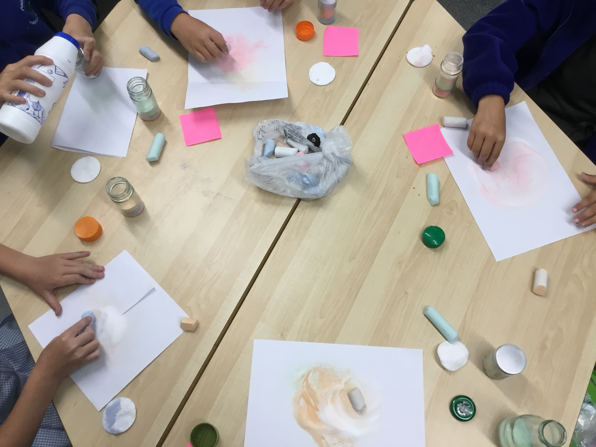
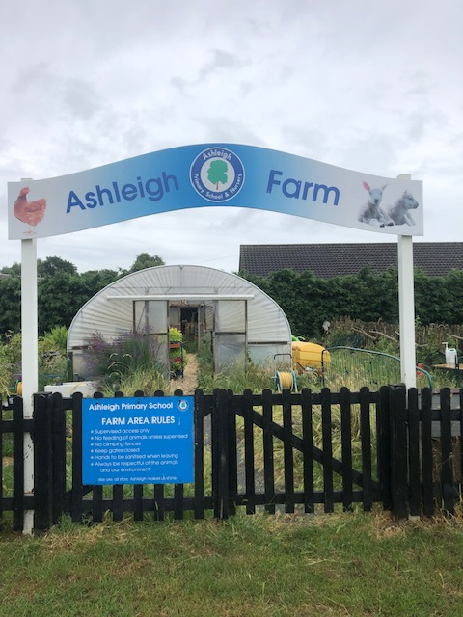
Regulate and reflect
Regulate: Regulation by an emotionally available adult | Attachment play Using outside spaces and the farm Sensory circuits Create and implement individual plans Develop strategies with children to support their emotions
Reflect: To make sense out of feelings | 1:1 time outside the classroom with a trusted adult Variety of tools in sessions Parent support Self-reflection Transition support
https://www.justonenorfolk.nhs.uk/emotional-health/parental-emotional-health/every-relationship-matters-in-norfolk/
https://www.justonenorfolk.nhs.uk/emotional-health/parental-emotional-health/triple-p-family-transitions/
https://www.justonenorfolk.nhs.uk/emotional-health/parental-emotional-health/one-plus-one/

Slide 14
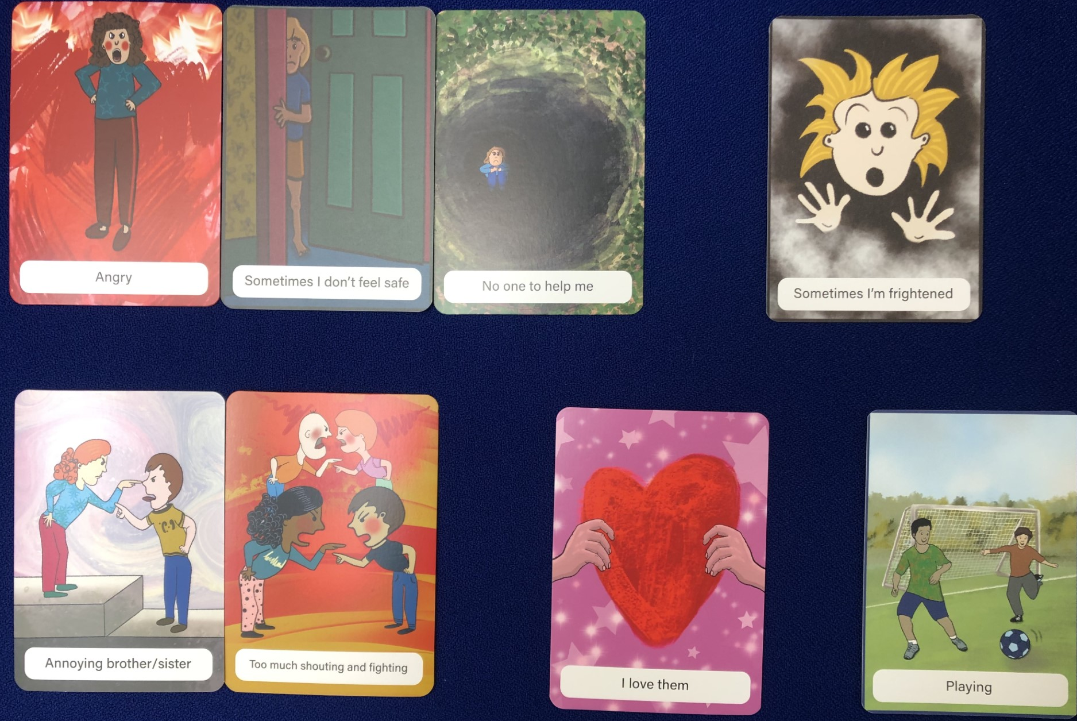
Pupil Level support
Child M finds it very difficult to talk about his life experiences. He will panic and freeze when he feels anyone is trying to get him to talk about his feelings and experiences. I allowed Child M to look through the cards and pick out those that meant something to him. He chose the cards pictured. I then followed up with empathy responses using the WIN (Wonder, Imagine, Notice) approach which encouraged the child to connect with his feelings rather than logical thinking.
“I wonder why you picked out this card?”
“I imagine you must have felt so frightened when mummy and daddy argued.”
“So, what I hear is that when mummy and daddy argue, there is no one to help you and make you feel safe.”
“You love your mummy and your daddy and your sisters so much. You want the arguments to stop.”

Slide 15
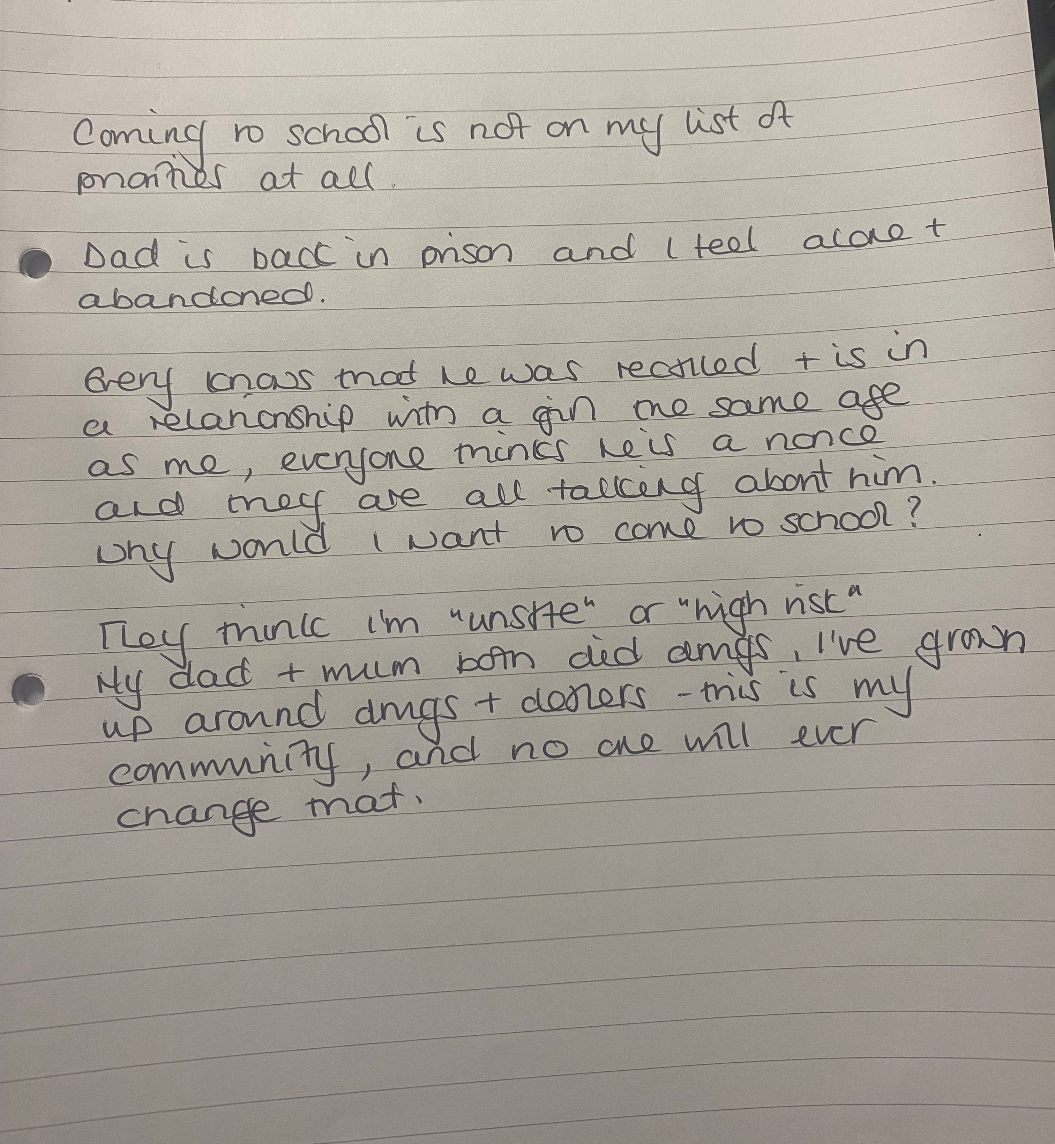
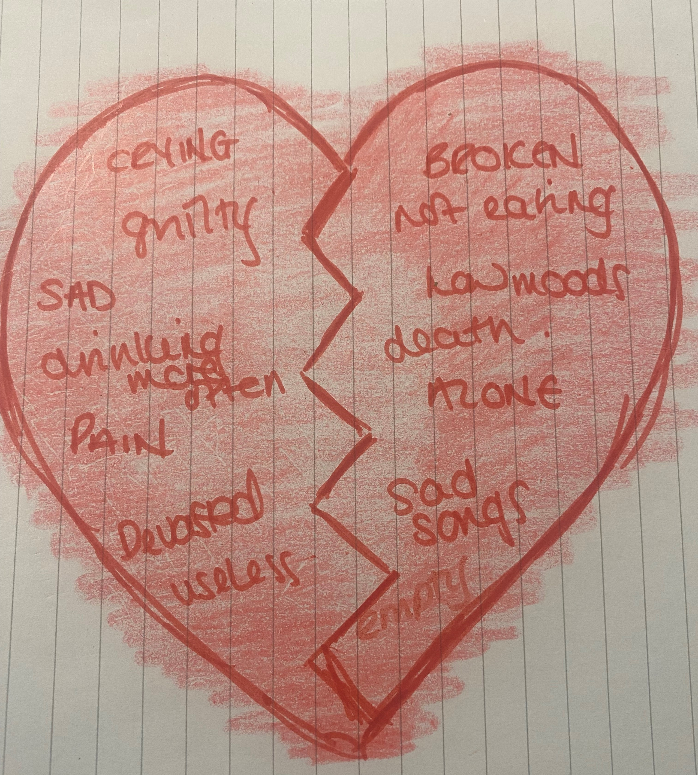
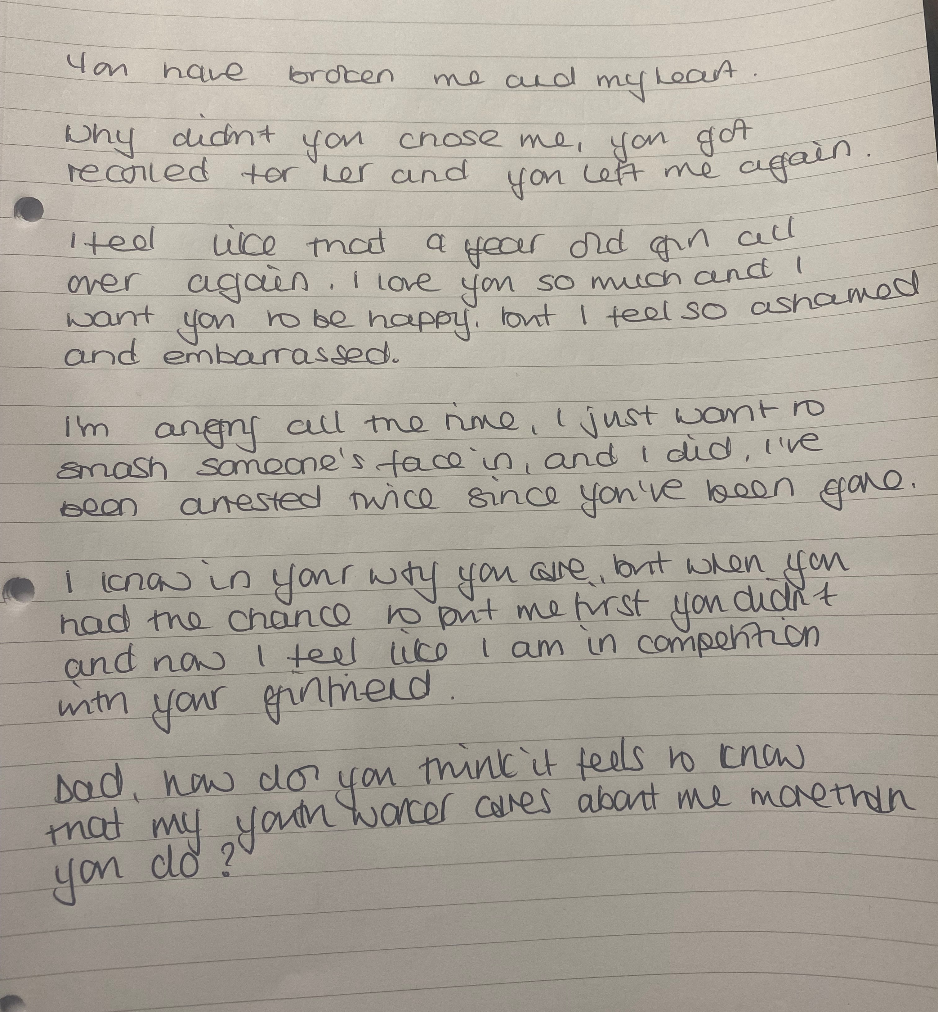
Supporting Lucy
Case Study: ‘I wish my teacher knew…’, Jamila Thompson, Youth Support Worker

Slide 16
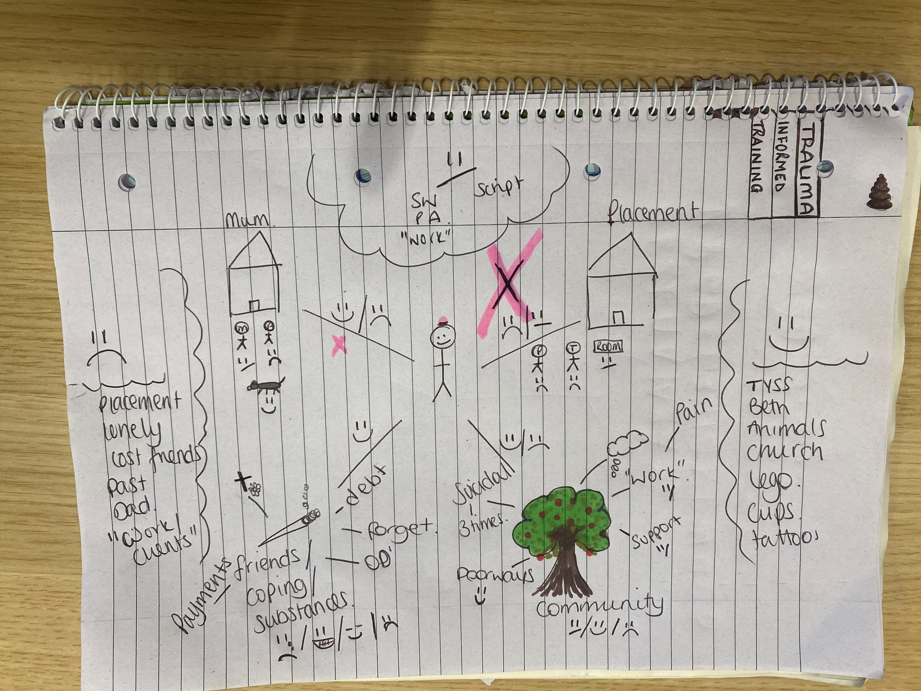
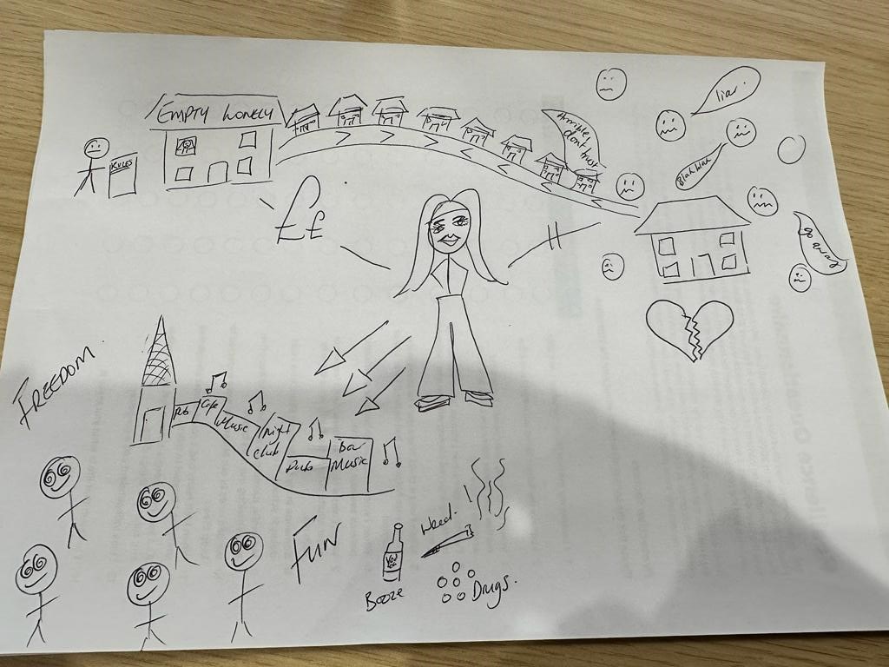
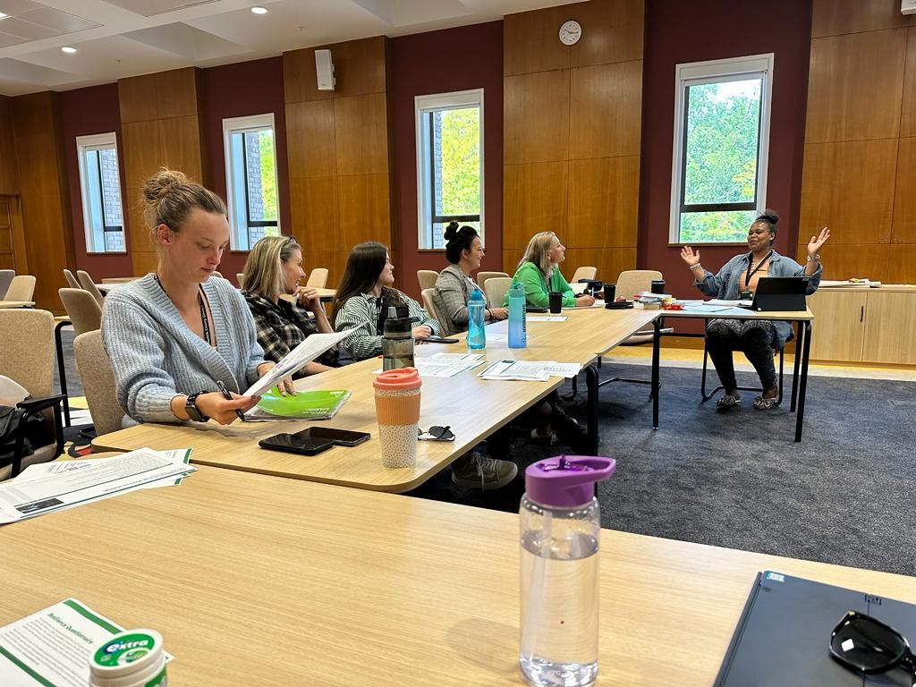
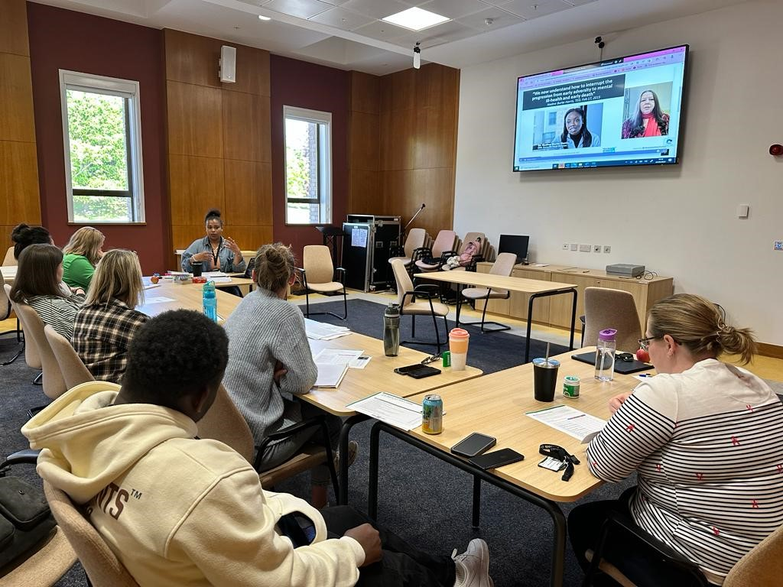
Wider service approach
“Brilliant workshop, made me really think outside the box of how to develop my thinking and best practice for those YP who have experienced trauma.”
“So insightful, simple interventions that we can use, like the blowing of bubbles – genius”
“You created a safe environment for us to discuss how we can challenge the narrative around some young people, but also be with them on the journey of trauma recovery”

Slide 17

Wider service approach
Changes made:
Trauma consultations
Youth Justice Service – Parenting Worker, Parenting Group use of PACE, addressing intergenerational trauma
Resource box for all Youth Workers
Fortnightly supervision, trauma informed rather than looking at behaviours looking at each child’s trauma
Use of ACE model in group supervision
Library of Margot Sunderland

Slide 18
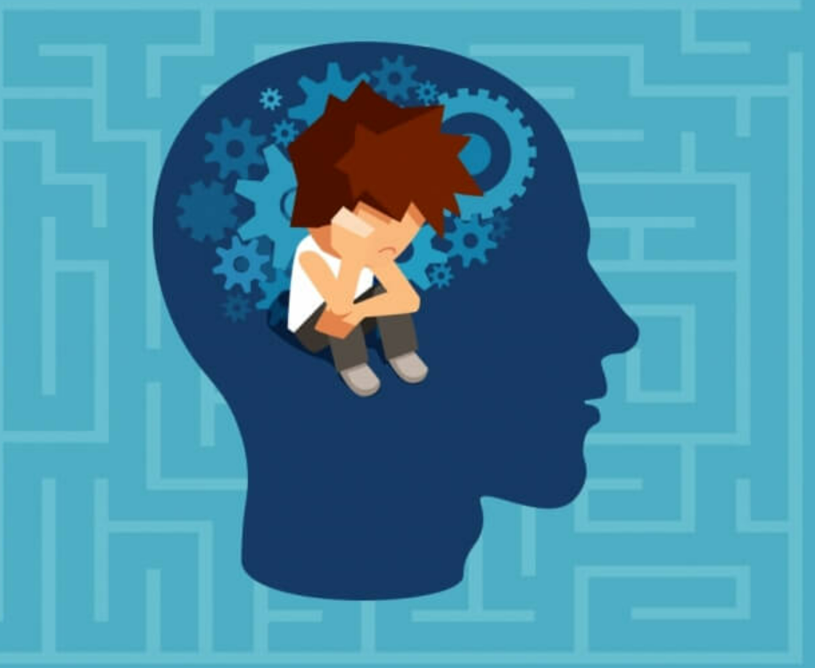
Begin at the end – what do I want for the young people I work with?
Case Study: Trauma Informed Programme for NEET Care Leavers, Laura Bay, Virtual School
Education – They have enjoyed completing their course and found it purposeful
Training – They are qualified and ready for work
Employment – They are ready and willing to take on more responsibility within their role
Surface level challenges:
Disengaged and lack of motivation
Lack of qualifications and experience
Not turning up to meetings
Low levels of retention
What I now know this could be:
Lack of Emotionally Available Adult when experiencing childhood trauma
Under-developed executive functions
Under active seeking system
Lack of enriching environments

Slide 19
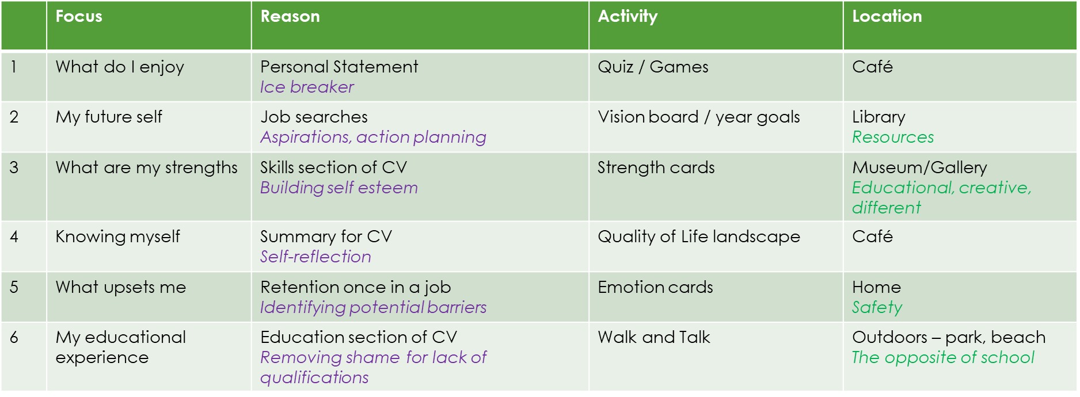
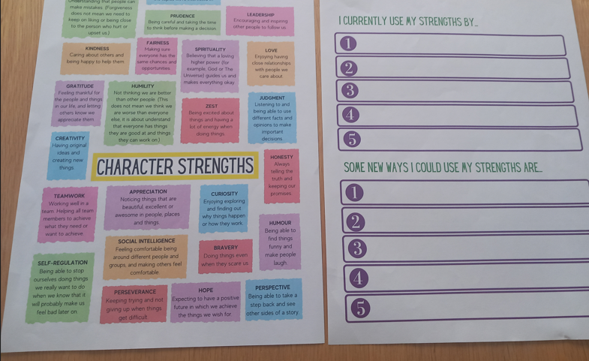
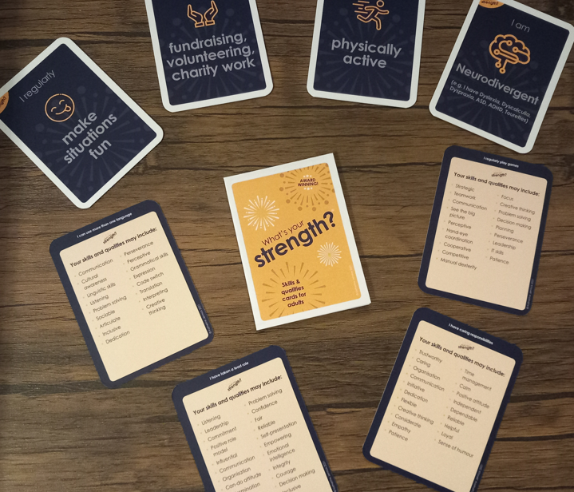
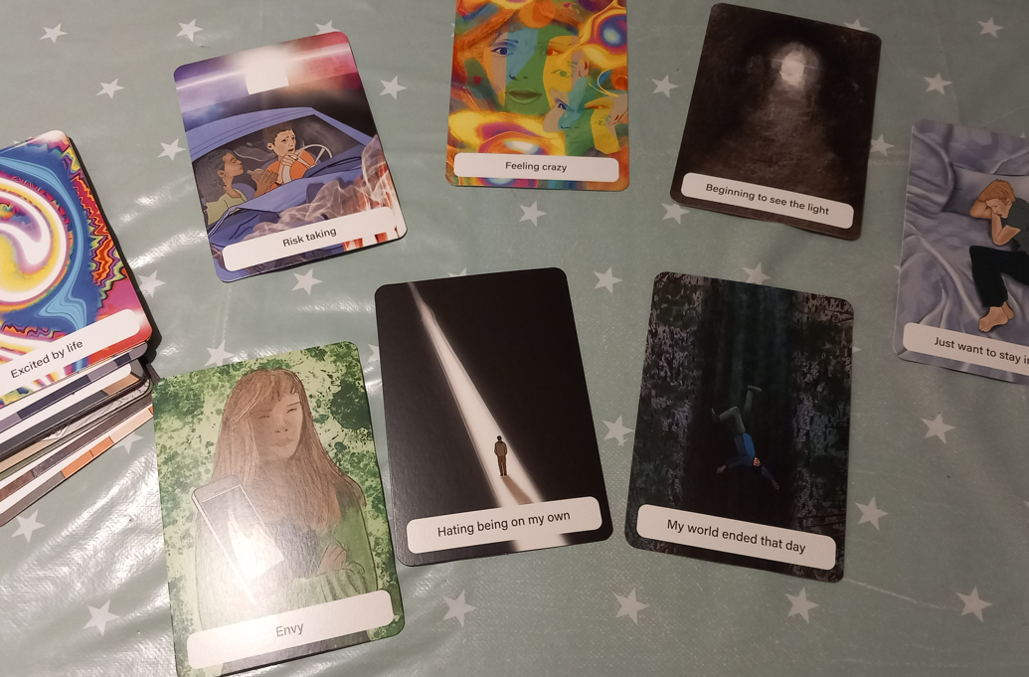
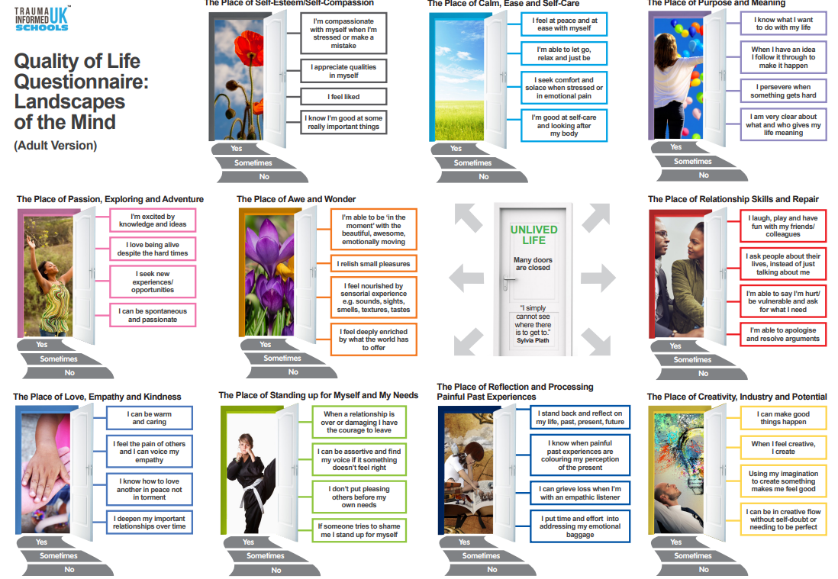
Stage 1 – Behind the scenes
Stage 2 – Becoming one of their Emotionally Available Adults
Care experienced skills

Slide 20
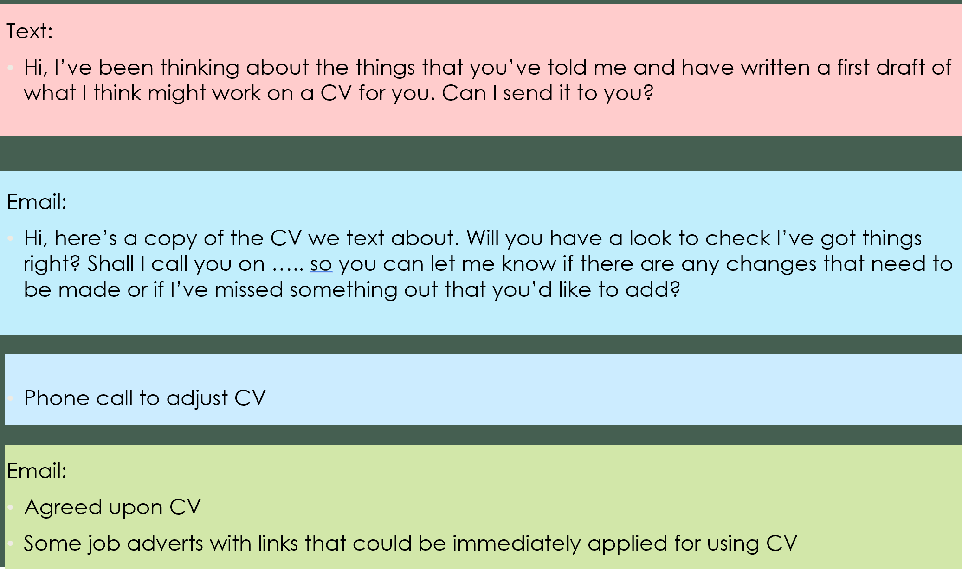
Stage 3 – Moving into Education, Employment or Training
Stage 4 – Remaining in Education, Employment or Training
Encourage asking for a work mentor
Calendar reminders – day before “good luck” text
Phone catch-up – after 1st week
Face to face catch-up – after first month and 6 months
Establishing an EAA at work
Showing that you’re still keeping them in mind
Reflection and moving forward

Slide 21
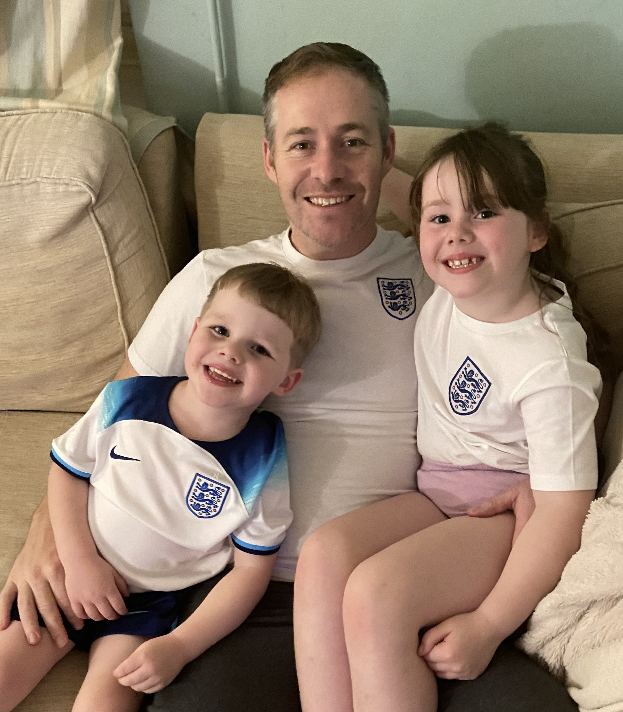
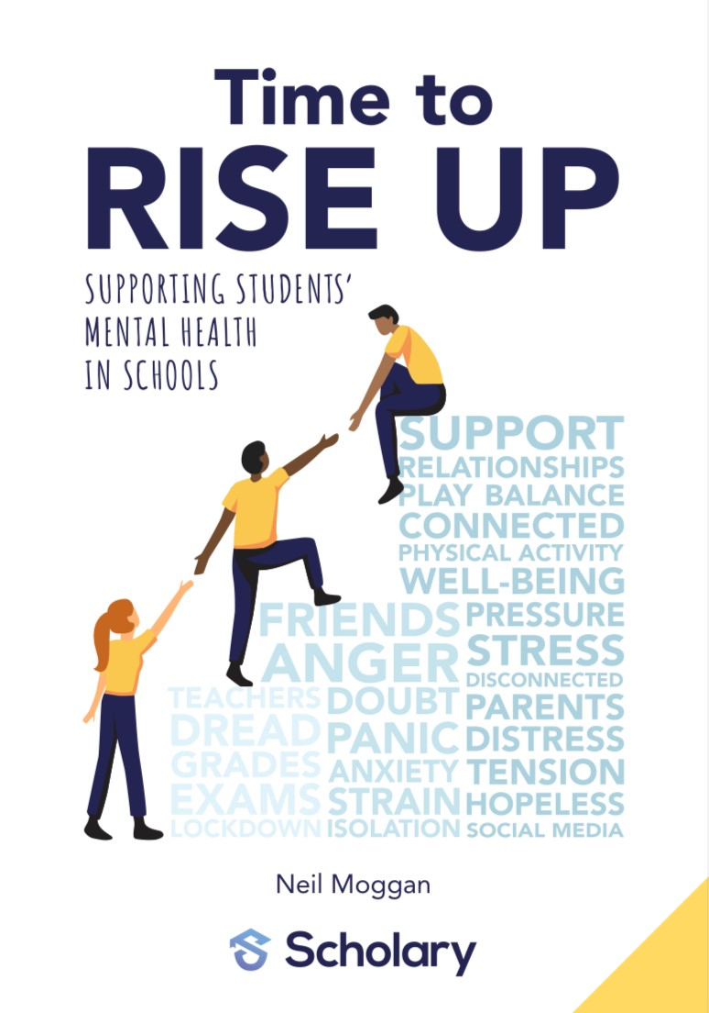


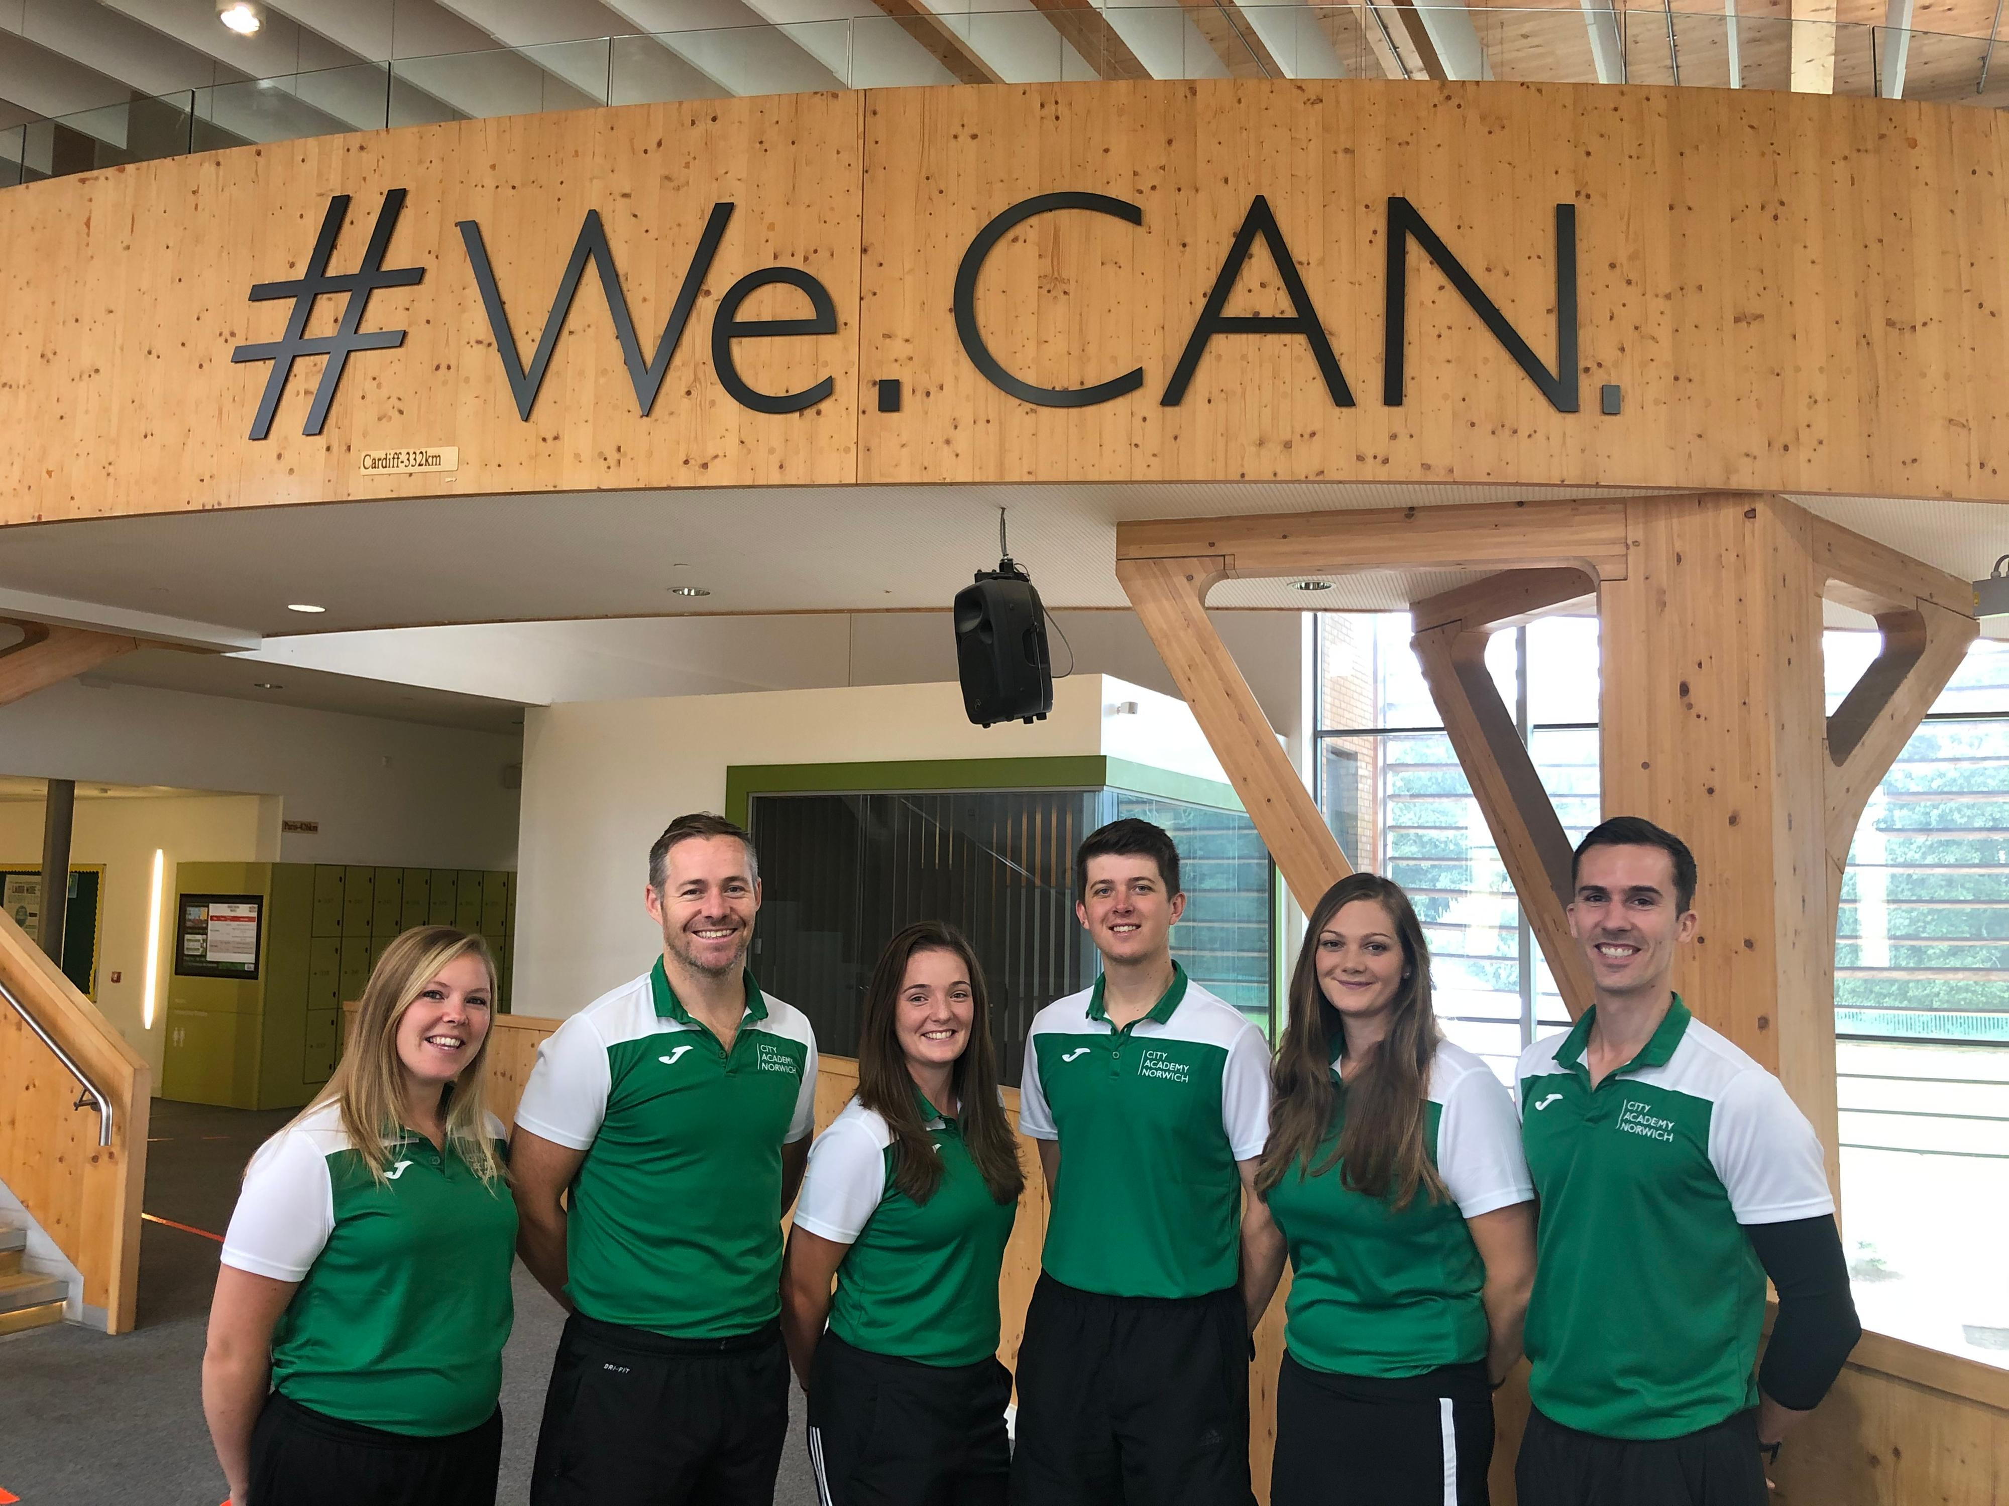

NEIL MOggan
My Why:
To transform the life chances of young people and their teachers.

Slide 22
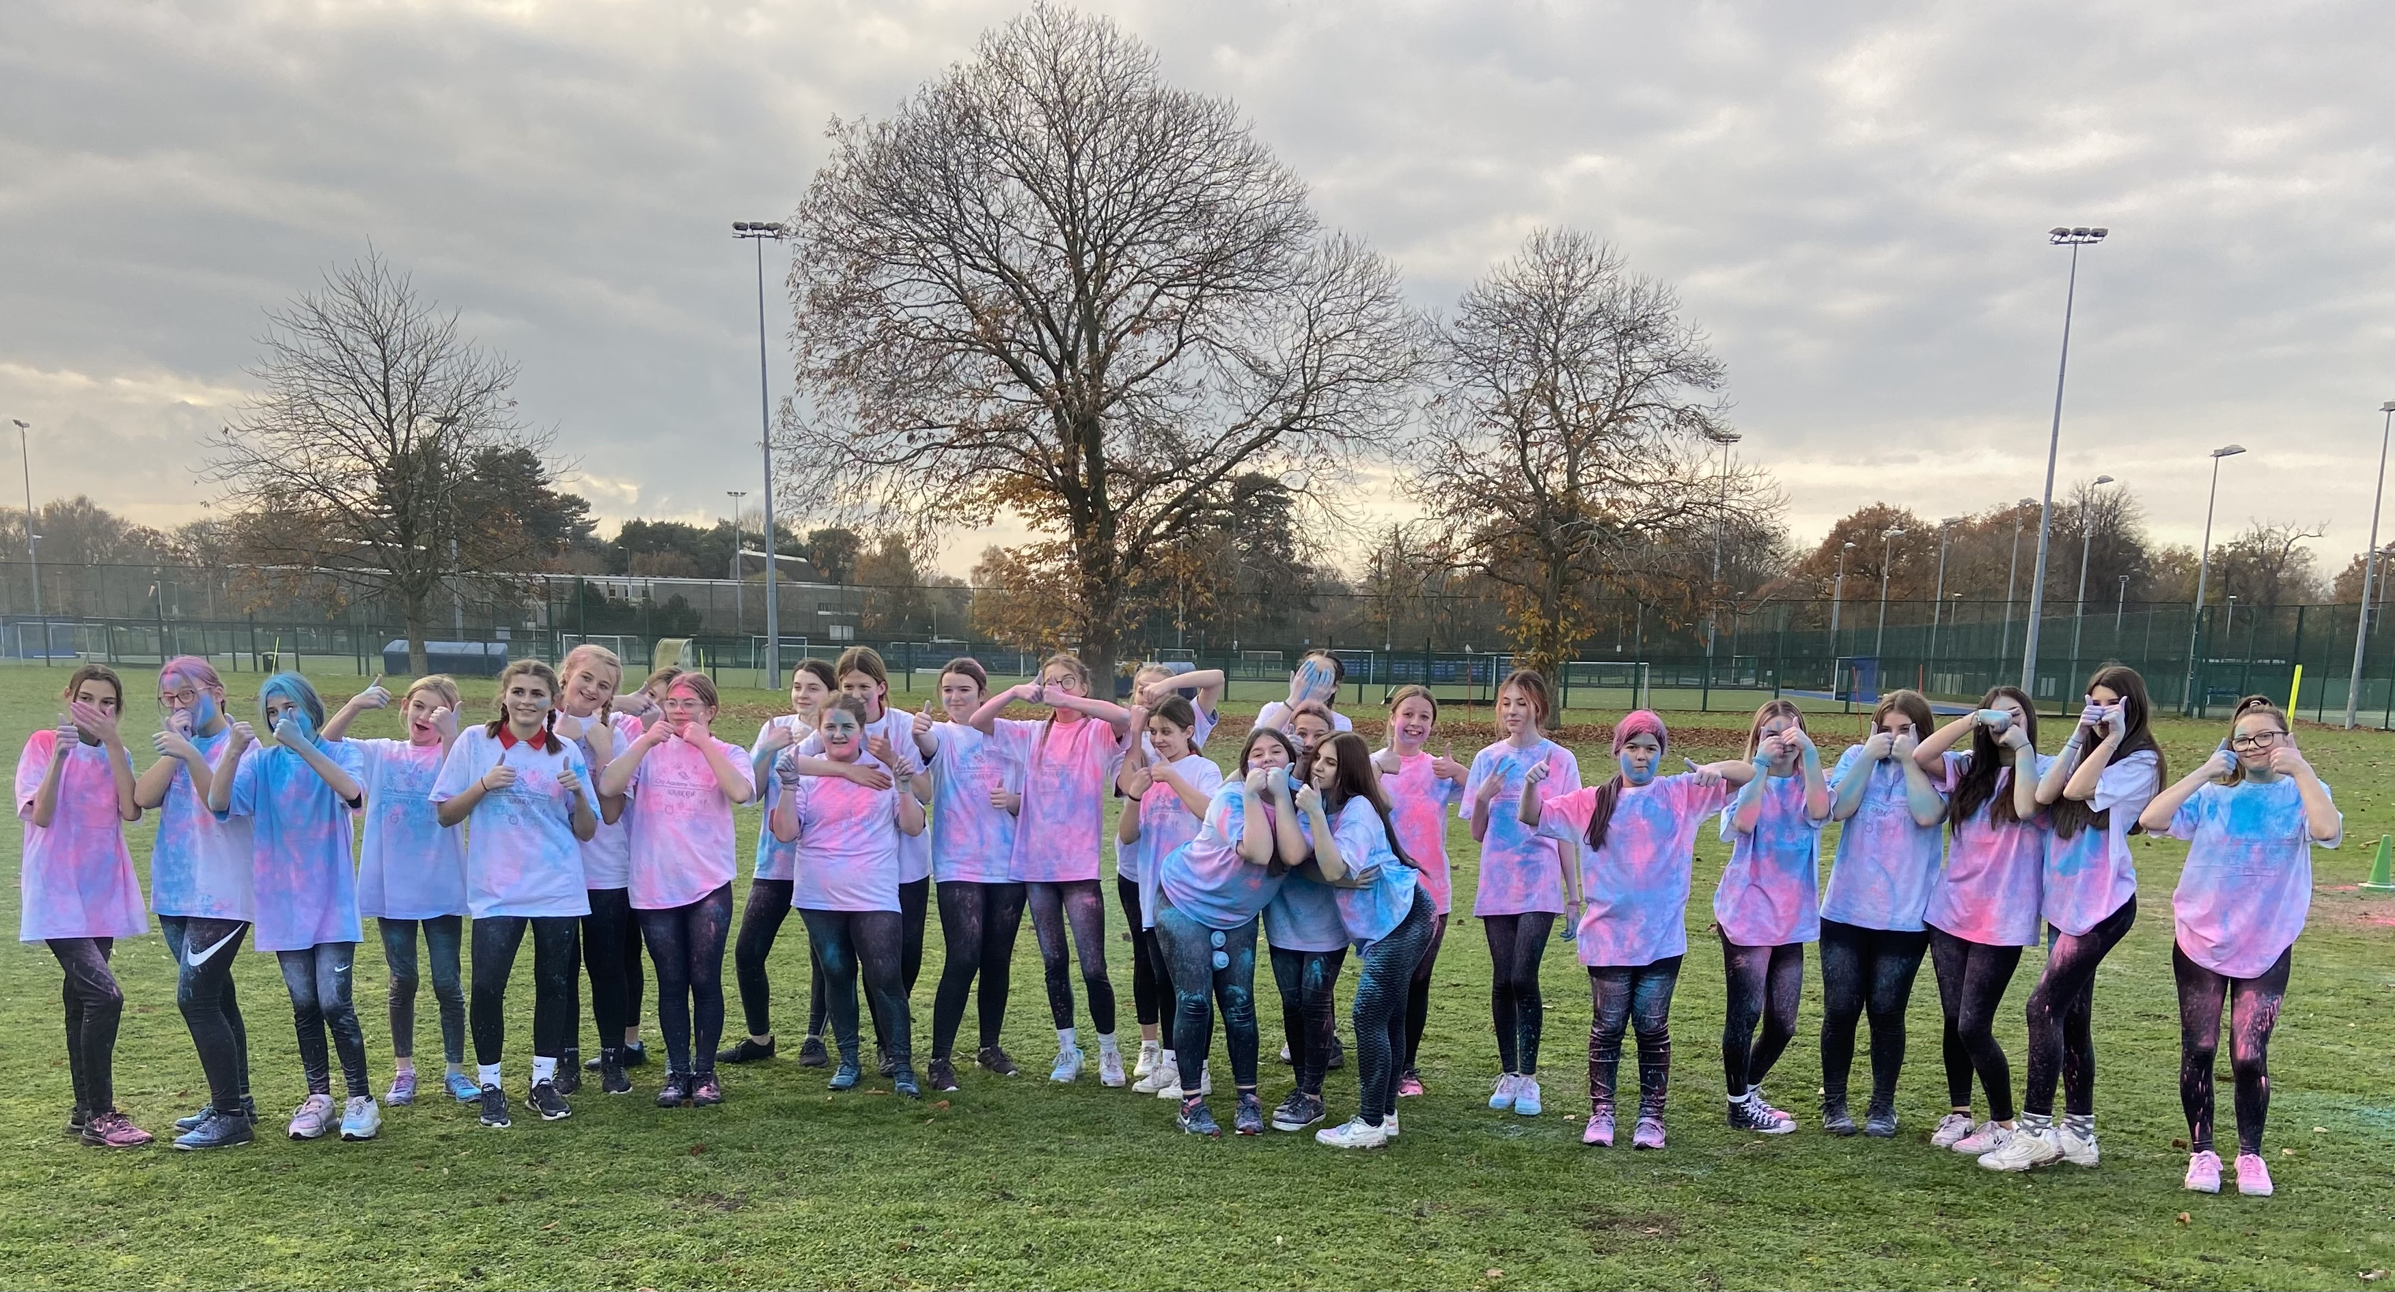
Post lockdown formula
THE POST LOCKDOWN FORMULA
Many frontline educators are teaching with their hands tied behind their back by not being trained in TIP.
Educators CAN & Do make a huge difference and change lives.
Quality Relationships +
Physical Activity & Play +
Early Intervention Mental Wellbeing Programmes =
A Turnaround Teacher
Our mission - To provide busy educators with the knowledge and strategies that they need to know to make a difference
© Future Action 2023

Slide 23
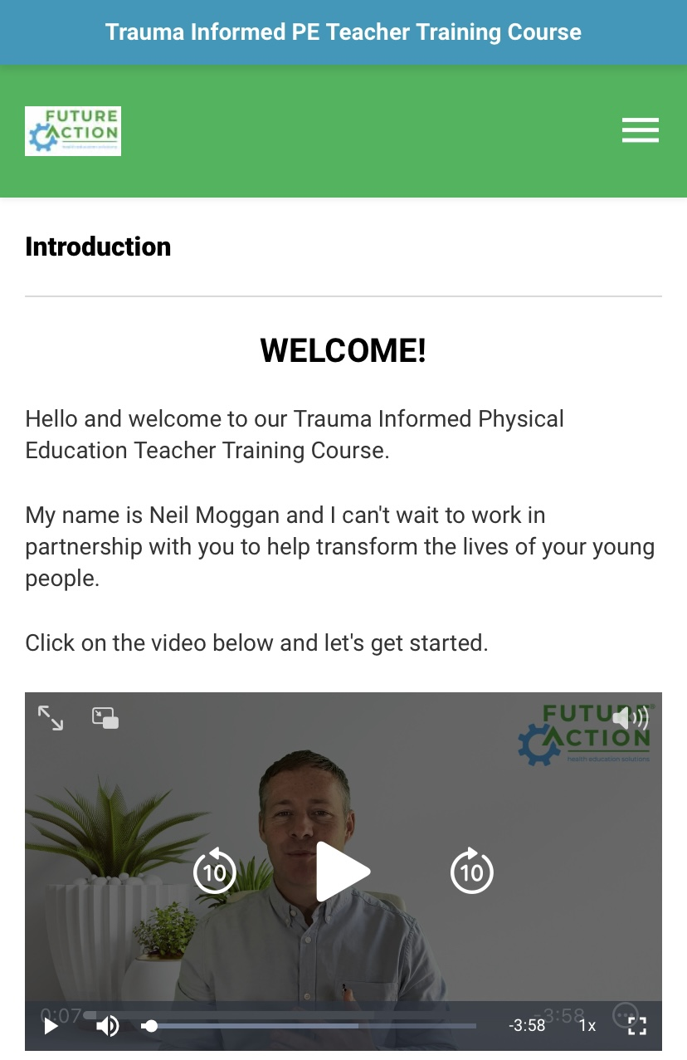
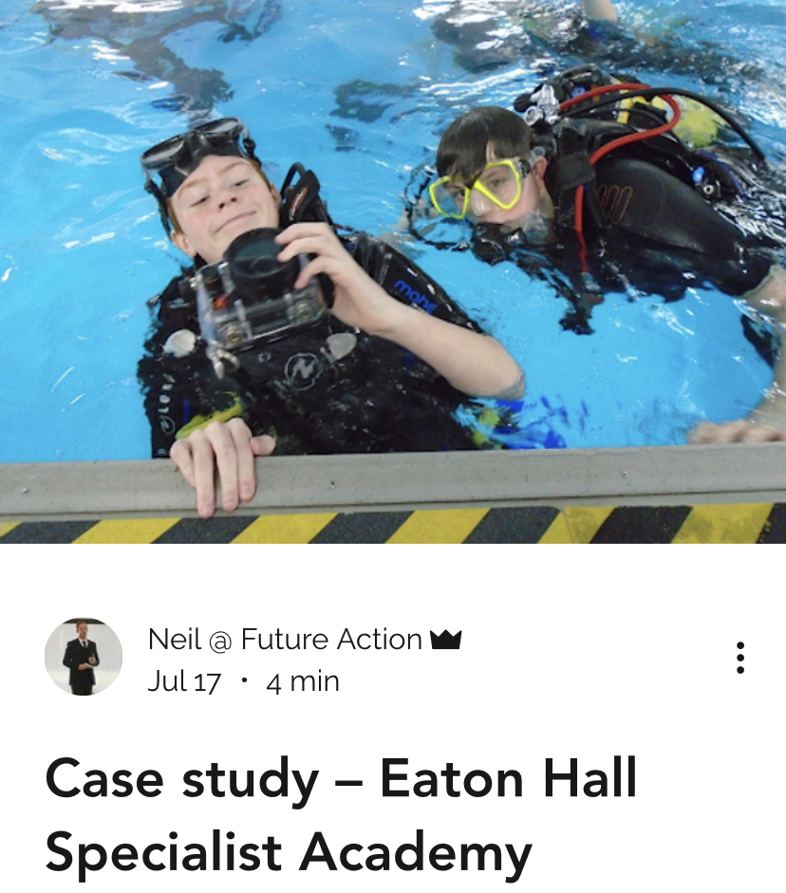
The COURSEs
Online training courses that equip educators with the knowledge, strategies, and tools to effectively integrate trauma informed practices within their setting.
Educators time is precious.
TIPE: 3 hours – Anytime, anywhere.
RISE Up: 5 hours
Videos, reflective tasks, case studies, editable resources.

Slide 24
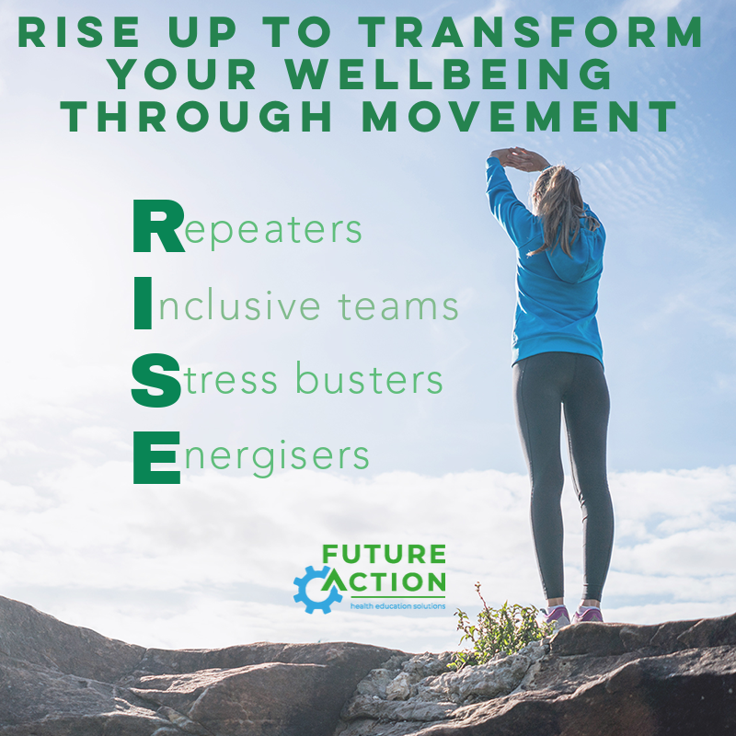
THE RISE UP EARLY Intervention mental wellbeing programme aims to:
Identify young people struggling with their mental health and direct them to the specialist support they need asap.
Help young people develop a self-care toolbox to protect and build their mental wellbeing to transform their life chances.
Teach the link between physical activity and mental wellbeing.

Slide 25
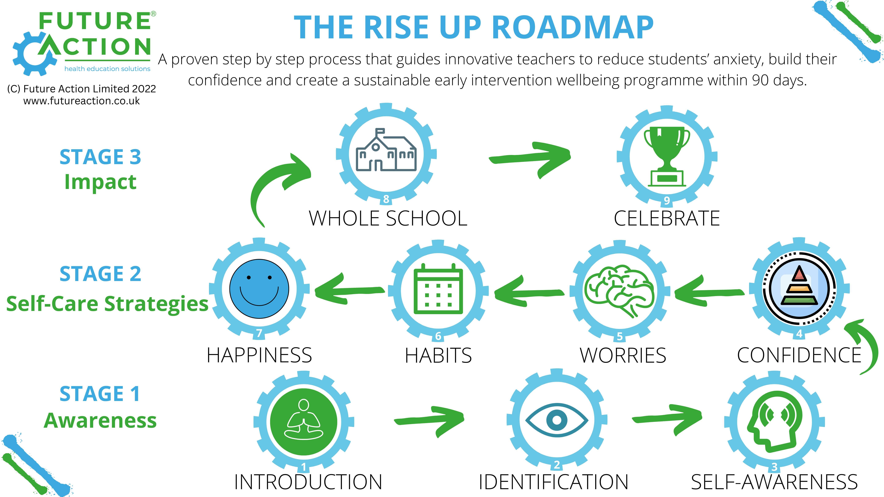
The Rise Up Roadmap

Slide 26
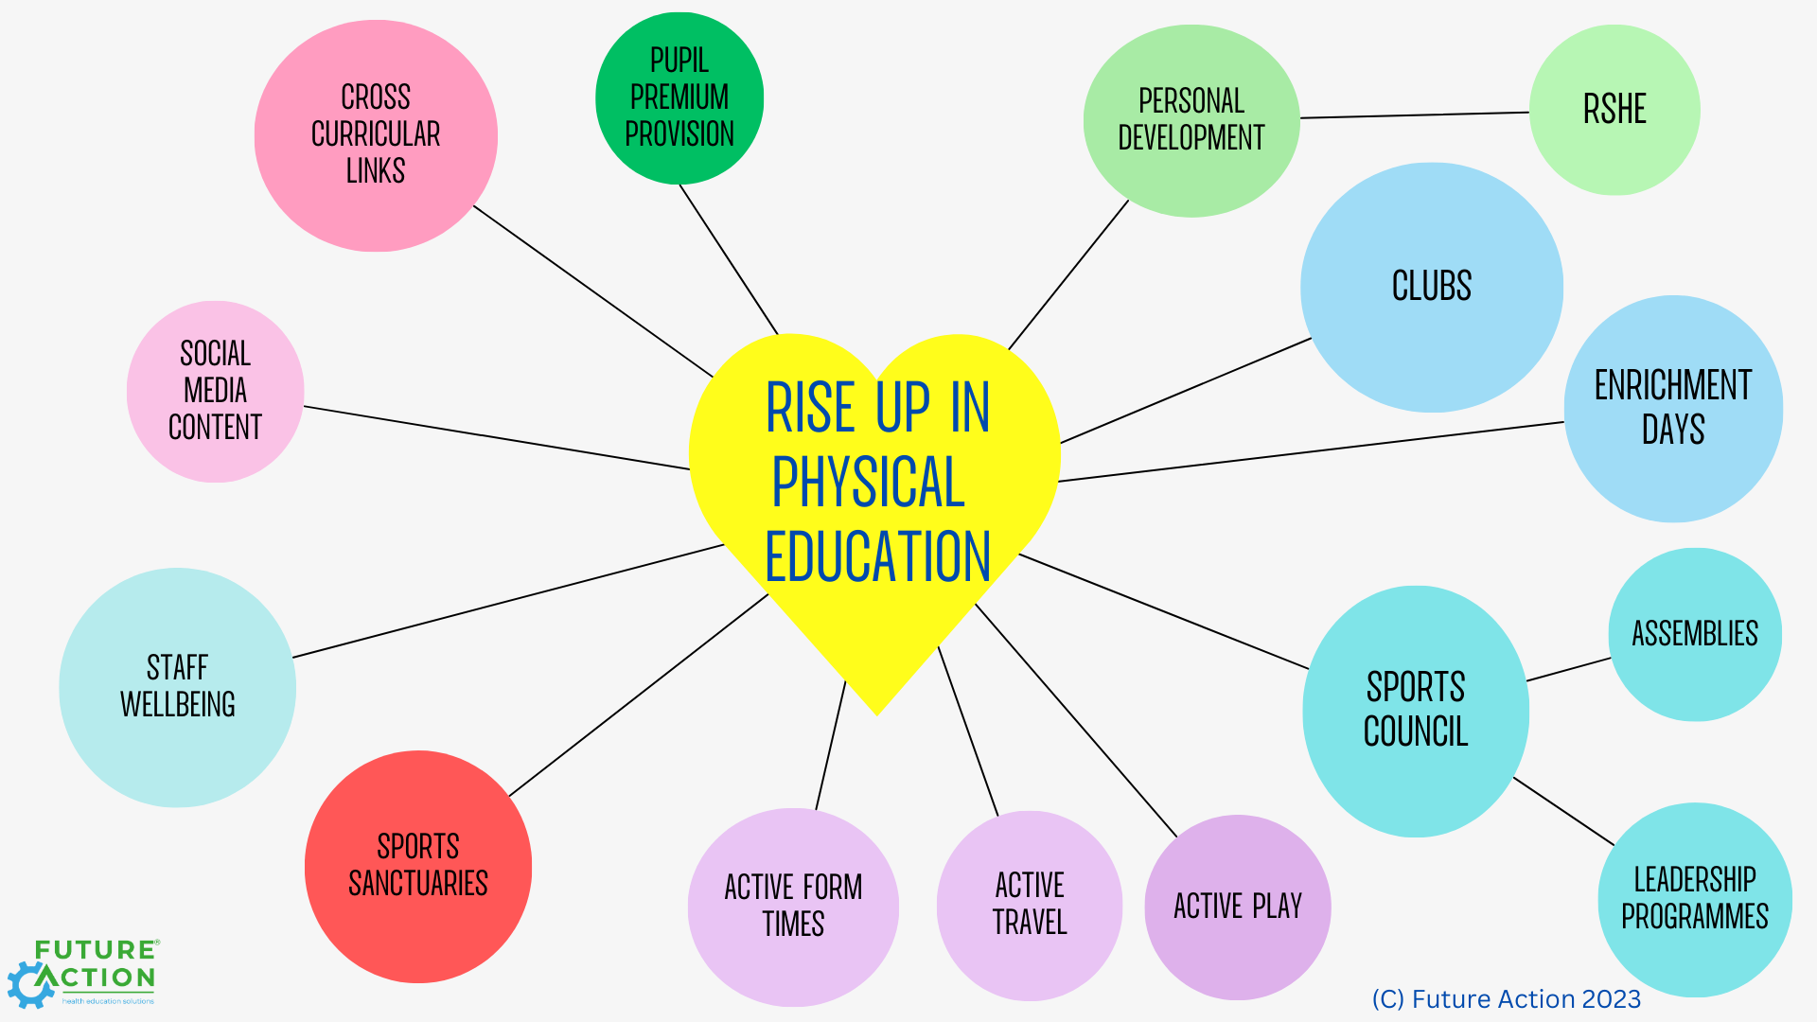
Agency & Creating Whole School Impact

Slide 27
Turnaround teachers in norfolk
Understanding the evidence based, and the long term expected outcomes for young people without interventions.
A safe space to reflect on existing practice and whether it is still serving us to get the best out of our young people.
‘It has made me reflect quite seriously on my interactions with pupils and how I can make these more positive for us both.’
James Kemp, Head of PE, Diss High

Slide 28
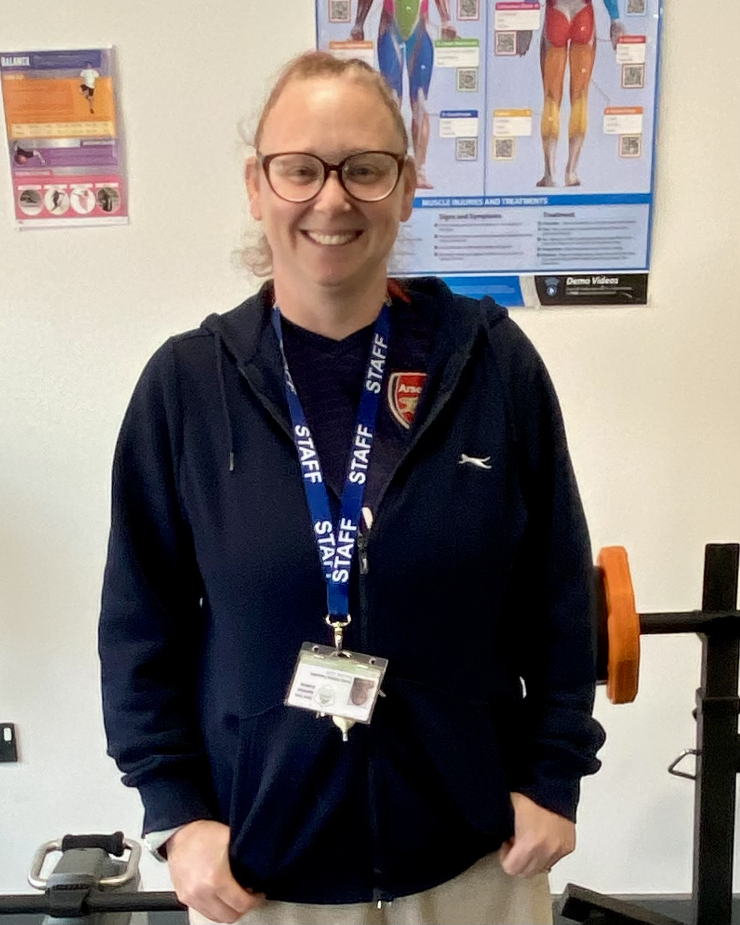
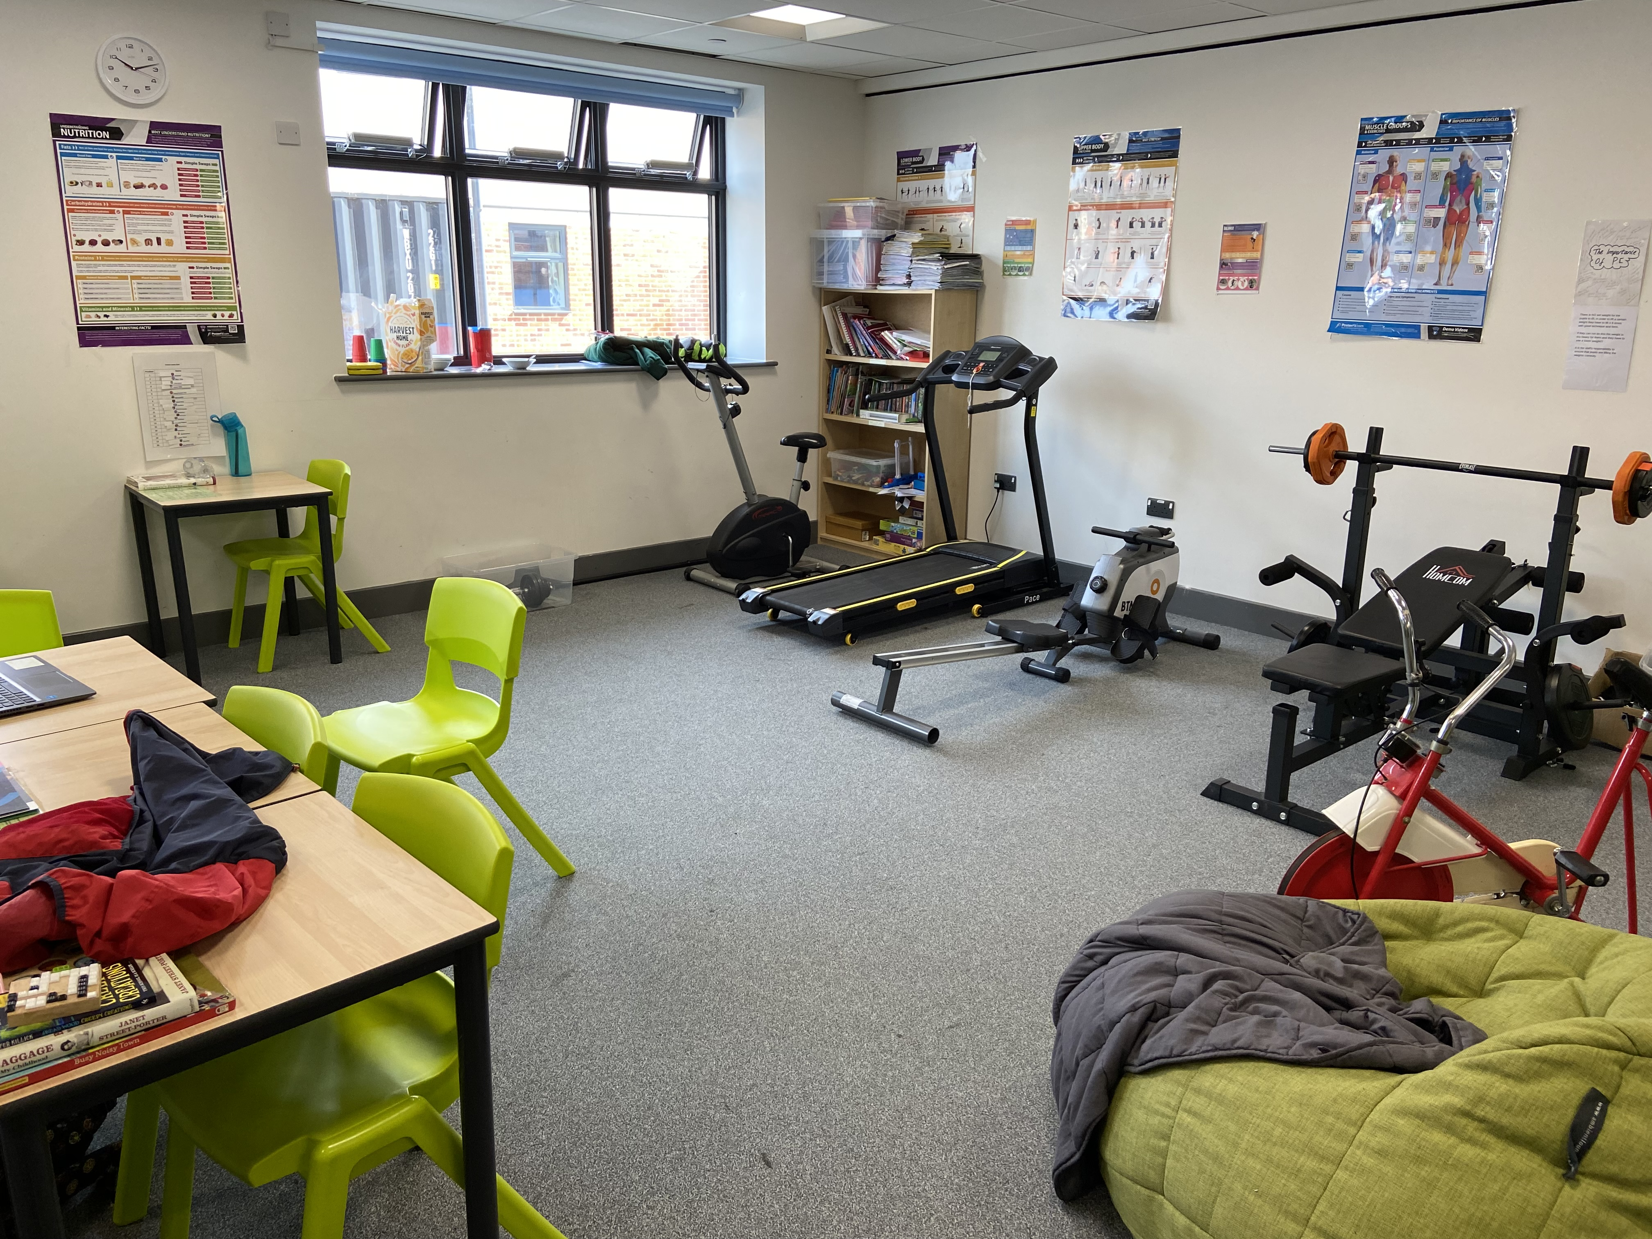
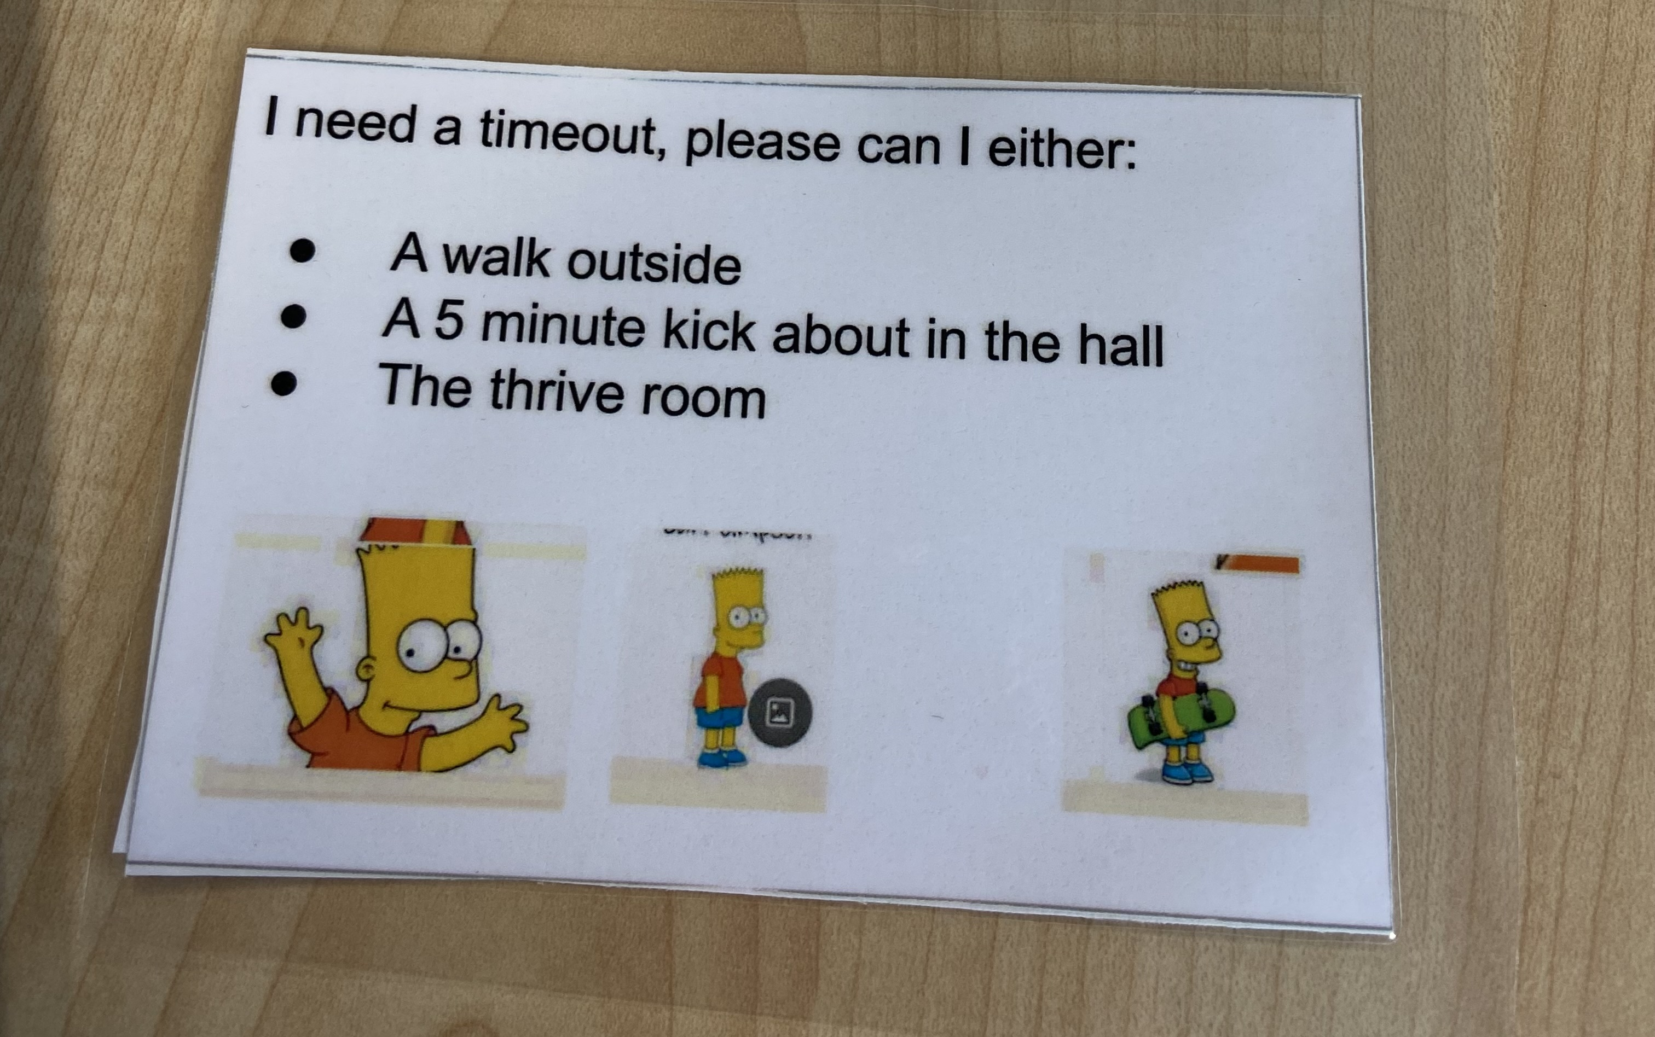
Turnaround teachers in norfolk
Anita Fiddes-Kappadia – PE Lead at Bure Park Specialist Academy - Using movement to state regulate and develop a feeling of belonging.
‘There has been a decrease in the number of physical holds when we intervene quickly with interventions.
The boys can come out for 5-10 minutes to regulate and then return to the lesson. It stops problems from escalating. Knowing our children’s triggers, and the activities they need and like to self-regulate is key to this.
The approach has benefitted all our students across the school.
We have 4 Children in Care and 8 Children with a social worker, and they all use the equipment to regulate and prevent issues from escalating.’
‘Movement makes me happy.’ Year 7 student.

Slide 29
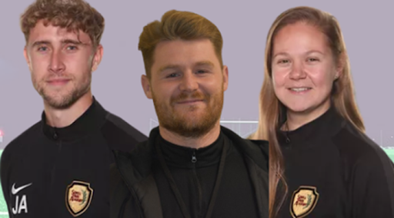
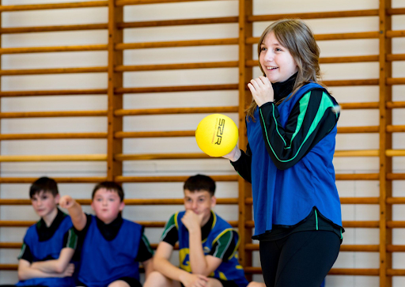
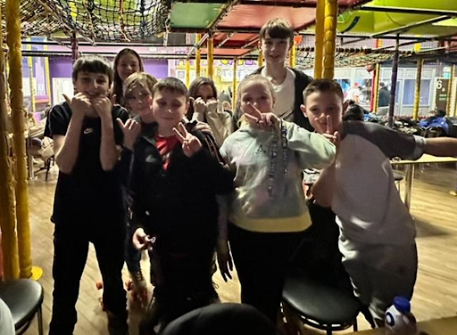
Turnaround teachers in norfolk
Lauren Perkins – Head of PE at Sewell Park - Being intentional about creating psychological safety with clear strategies
‘We wanted to make our young people feel psychologically safer so we allowed students who were struggling with accessing the PE curriculum to wear their own sports clothes to lessons. This meant that they were able to engage in the lesson and focus more on the content, rather than worry about what they looked like in the lesson. ’
Student voice:
“I know that if I am mad, I can just go to the gym and box a bit to feel better”
“I didn’t know that PE was so good for my brain”
“I can, like, enjoy PE and not all of it but for my mental health and that makes me feel happier in lesson”
“I didn’t know that I liked yoga because I was too scared before”
“Why didn’t we learn this before?”
“I love the lessons now.”
“Wearing clothes I feel comfortable in is so good. It makes me feel happy in lesson”

Slide 30
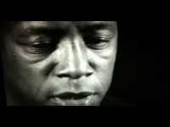
Relationships Matter

Slide 31
Questions and Answers
DDP Network - what does that mean or refer to?
DDP stands for Dyadic Developmental Practice and the link to learn more about PACE (Playfulness, Acceptance, Curiosity and Empathy) is on slide 13. The link takes you through to more information.
Books referenced within the session:
Ordinary Magic: Resilience in Development, Ann S. Masten
The Body Keeps the Score: Brain, Mind and Body in the Healing of Trauma, Bessel Van Der Kolk
Can training mentioned today be accessed by non-teaching staff?
Please contact virtual.schoolscwsw@norfolk.gov.uk for more information on our trauma and attachment aware practice in schools training offer.

