Slide 1


Developing Special Educational Needs and Disabilities (SEND) Provision in Norfolk
Practice Week May 2024
Michael Bateman – Assistant Director for SEND Strategic Improvement and Partnerships
Maxine Blocksidge – Senior Advisor for SEND
Steph Askew – Senior Advisor for SEND
Notes:
Michael

Slide 2
Developing Special Educational Needs and Disabilities (SEND) Provision in Norfolk
Aims of the session:
To give an overview of Local First Inclusion (LFI) and plans to improve provision for children and young people (CYP) with SEND
An understanding of the themes and priorities in the Norfolk Area Special Educational Needs and Disabilities & Alternative Provision Strategy (NASAPS)
Notes:
Michael

Slide 3


What do you know about Local First Inclusion?
What do you know about the Norfolk Area SEND and AP Strategy?
Notes:
Michael – in chat – hands up

Slide 4
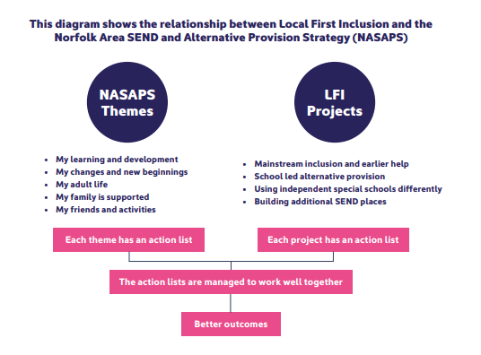
Local First Inclusion
Notes:
Michael

Slide 5



What’s happening to improve SEND and AP services and support in Norfolk
Notes:
Michael

Slide 6



Local First Inclusion
Local First Inclusion
Joint DfE & NCC investment
2023–2029
Notes:
Michael

Slide 7


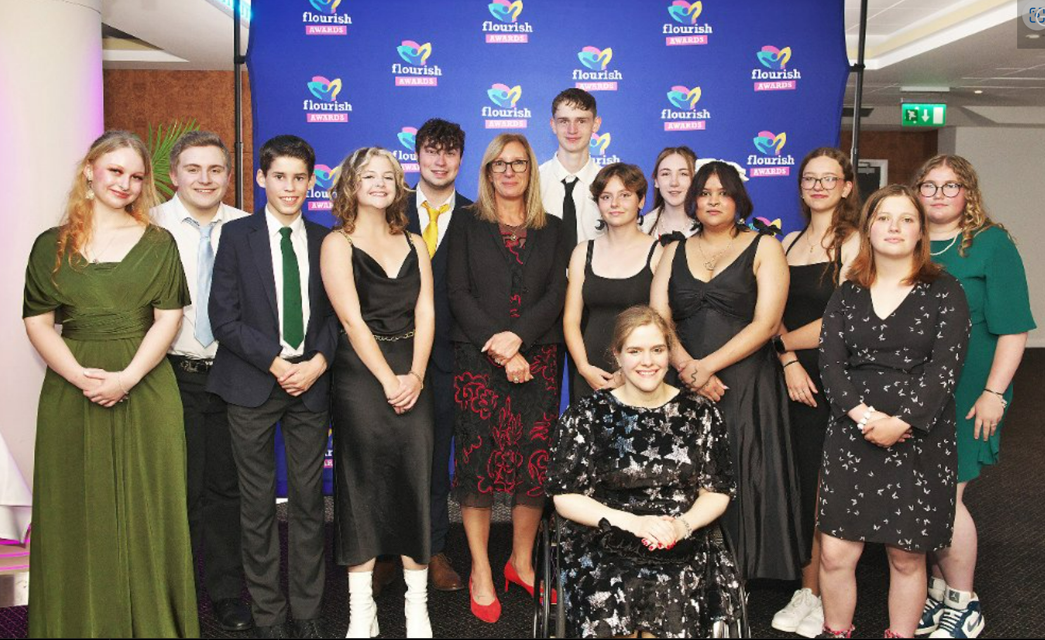
Flourish
“We pledge to implement the ‘sign along’ language to support children with SEND through their stages of development”
www.norfolk.gov.uk/flourish
Notes:
Michael

Slide 8
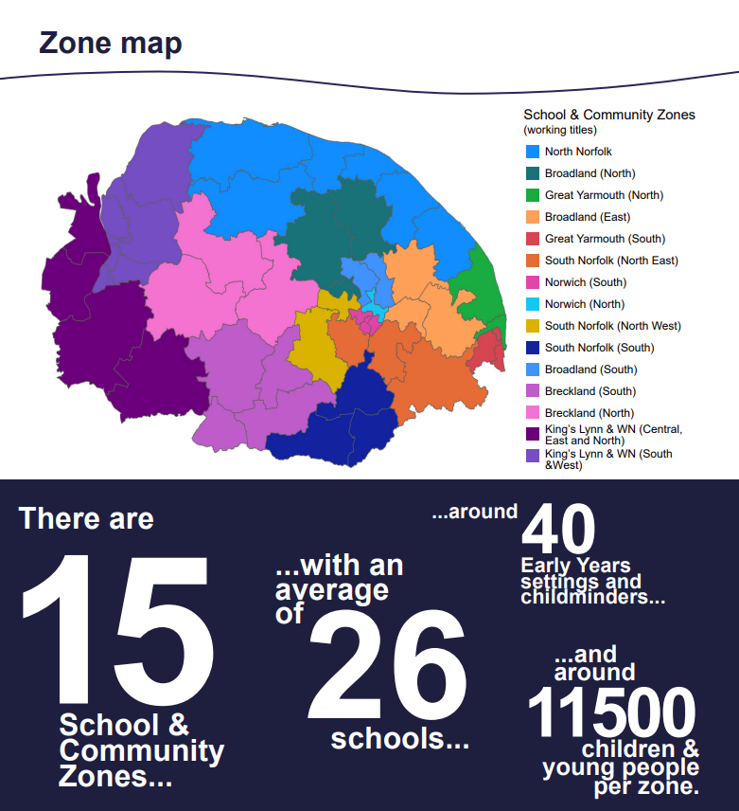
School and Community Teams
Local First Inclusion
Interventions with groups of children
1:1 interventions with children and families
Community and Place (projects and groupwork)
Interventions around the broad areas of SEND
Parenting support
Work with and alongside education settings
Notes:
Michael

Slide 9
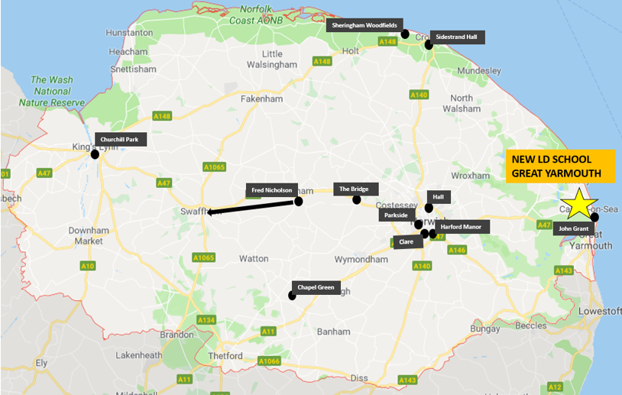
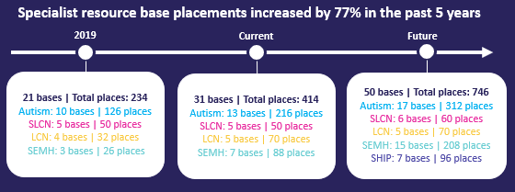
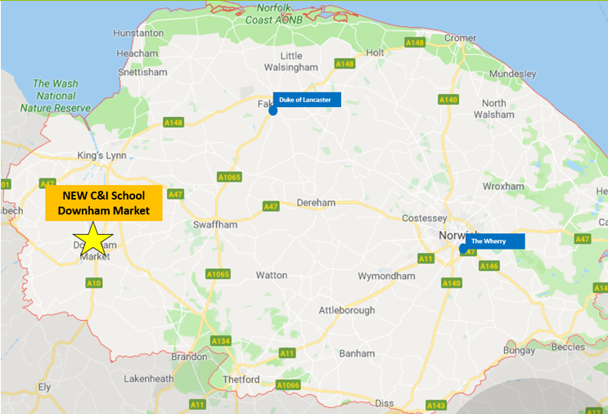
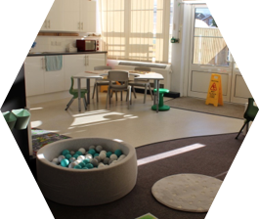
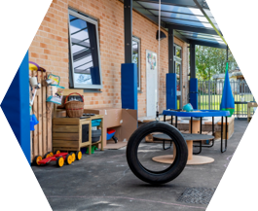
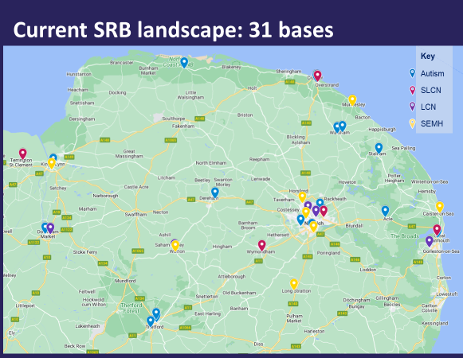
Local First Inclusion
New complex needs schools in development
Support in mainstream through expansion of the SRB family
Notes:
Michael

Slide 10
Norfolk Area SEND and Alternative Provision Strategy (NASAPS)
Health and Wellbeing Board
Children and Young People Strategic Alliance (CYPSA)
Local Inclusion Partnership (LIP)
NASAPS Community of Practise / Core Group
My learning and development
My changes and new beginnings
My adult life
My family is supported
My friends and activities
Our actions will focus on developing inclusive provision though listening to the voices of children and young people and understanding their experiences.
Our actions will focus on supporting children and young people and their families through involving them in planning for their next steps.
Our actions will focus on giving young people the information they need to make choices and become more independent as they move into adult life.
Our actions will focus on listening to what families need and providing easy access to information, advice, help and support.
Our actions will focus on widening the choice of activities for children and young people across Norfolk.
Notes:
Michael

Slide 11
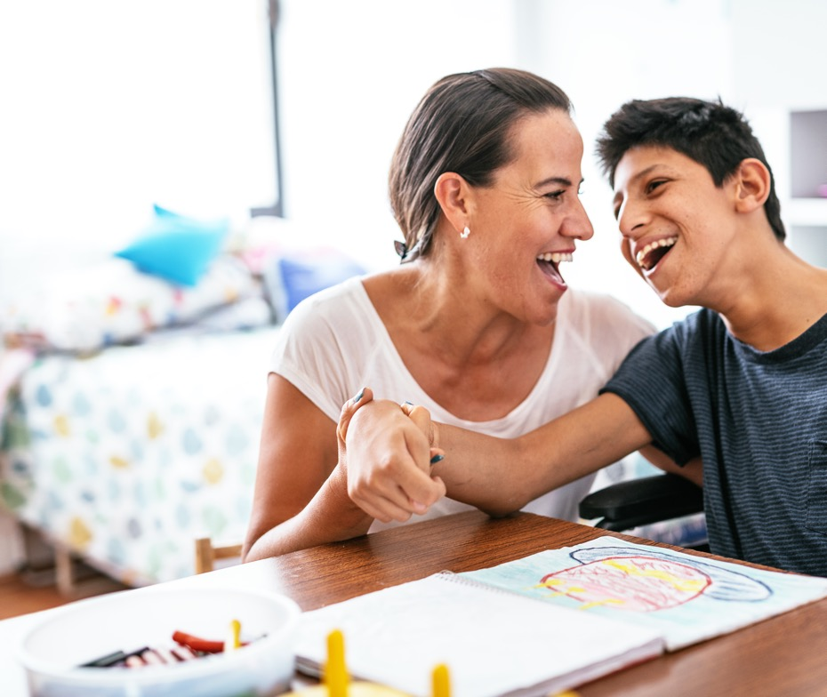

Norfolk Area SEND Strategy (NASS)
2019-2023
Norfolk Special Educational Needs and Disability (SEND) Alternative Provision (AP) Strategy (NASAPS) 2024-29
Notes:
Maxine

Slide 12
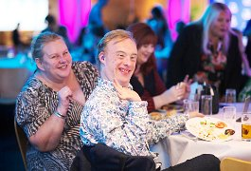
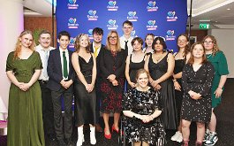
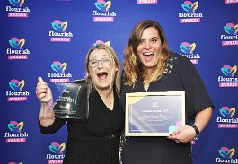
Norfolk Area SEND and Alternative Provision Strategy mission
To enable all children and young people (CYP) with special educational needs and disabilities (SEND) to FLOURISH by creating a supportive and inclusive community that will:
Strengthen relationships with family, friends and support networks
Support CYP’s learning and personal growth through education that meets their needs
Provide opportunities and support to prepare CYP for adult life
Support CYP to develop skills that help them to express themselves, be understood and influence decision making
Support families and CYP to have resilience and thrive
Support CYP to be confident in themselves and who they are as individuals
Create a safe and secure community, where CYP are included
Support CYP to lead their best healthy lives
Flourish Awards 2023
Working as a Community of Practice
‘Equal partners sharing a passion and responsibility for improving outcomes for children and young people with SEND’
Notes:
Maxine

Slide 13




How this strategy is being developed
SEND surveys
Data- informed
Co-production
Consultation
Notes:
Maxine

Slide 14

What do we mean by co-production in Norfolk?
“Working together and communicating as equals. Understanding and valuing one another’s unique insights and expertise to create a plan to bring about positive change.”
Notes:
Steph

Slide 15
Themes and priorities
My learning and development
My changes and new beginnings
My adult life
My family is supported
My friends and activities
Notes:
Steph

Slide 16

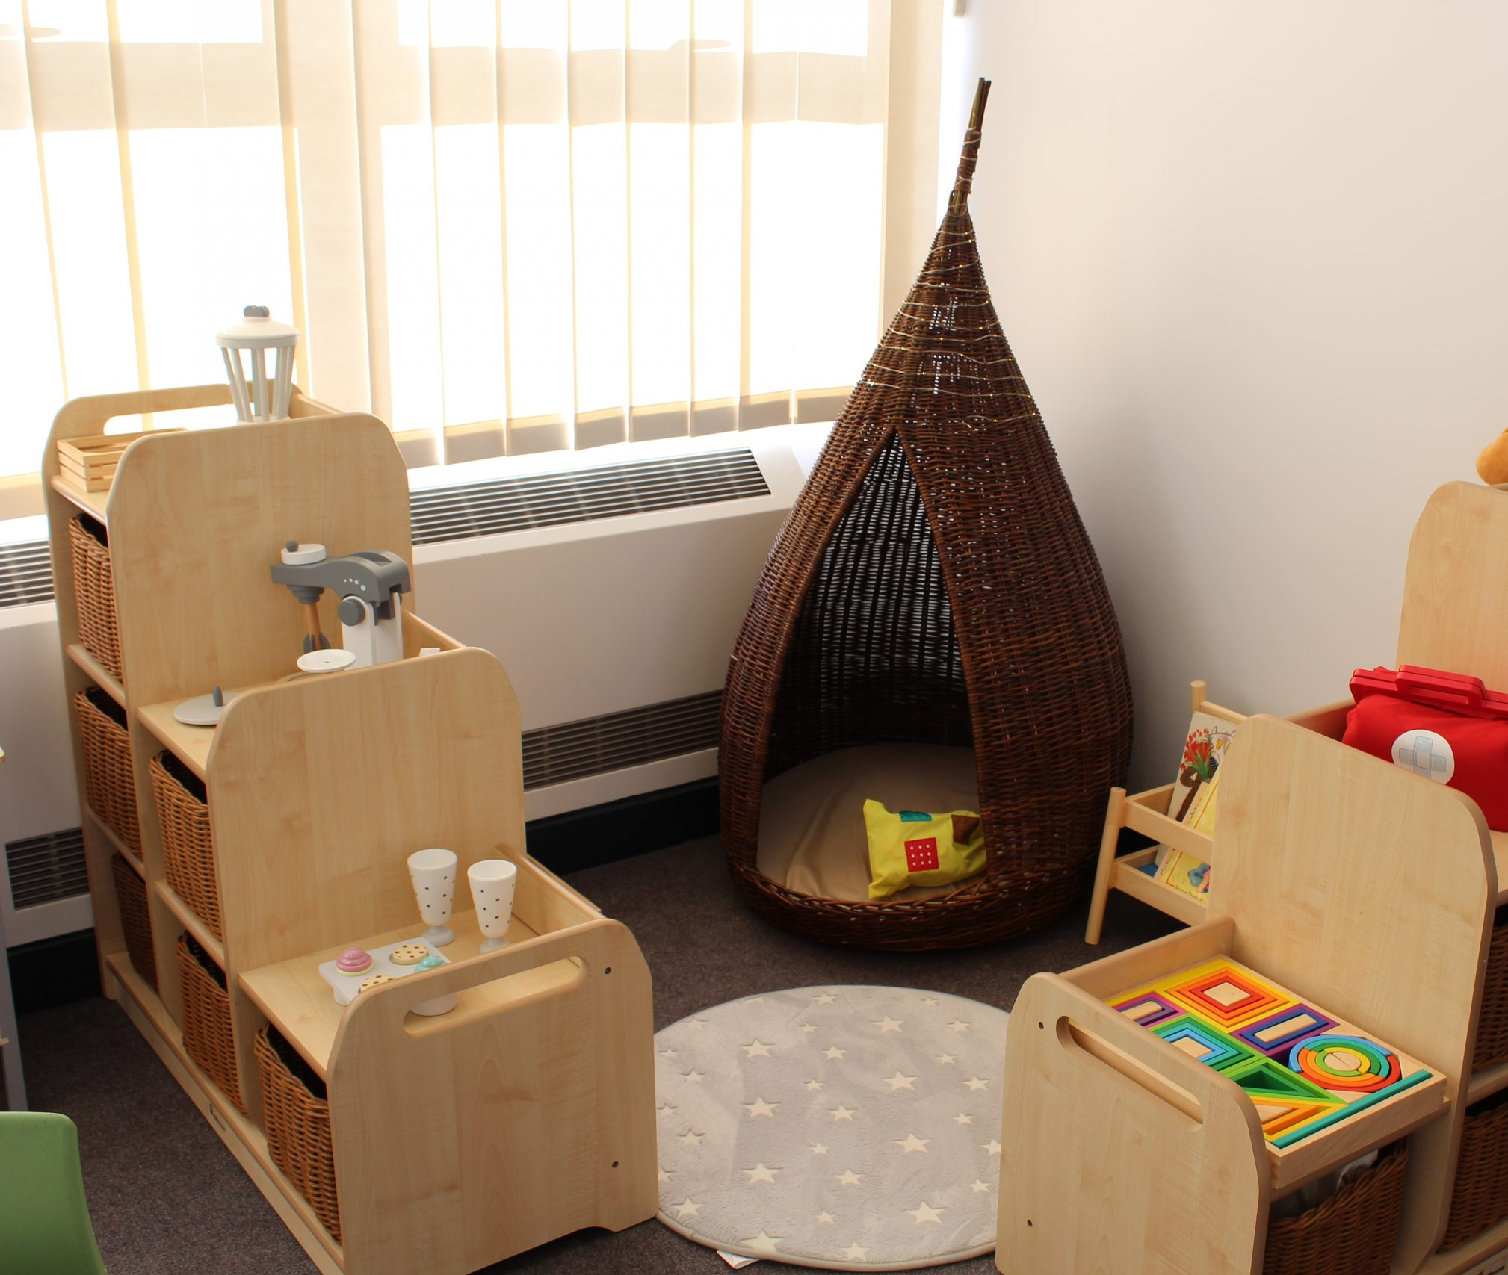
My learning and development
My learning opportunities and experiences help me to become the best that I can be
Developments and successes
Guide for SENDCos
“I feel safe in the Base. It’s calm and peaceful.”
“Thank you from the bottom of our hearts. You’ve helped my child so much this last year and we are forever thankful.”
Specialist Resource Bases (SRB)
Notes:
Steph

Slide 17

My learning and development - priorities and actions ​
Priorities
My education meets my needs and the needs of my family
My family and I welcome, safe and included in my place of education
All the adults in my place of education can meet my needs
I can share my views about my education and feel that they are listened to
I am provided with exciting experiences that help me learn
Action
Implement training for professionals on person-centred approaches
Notes:
Maxine

Slide 18


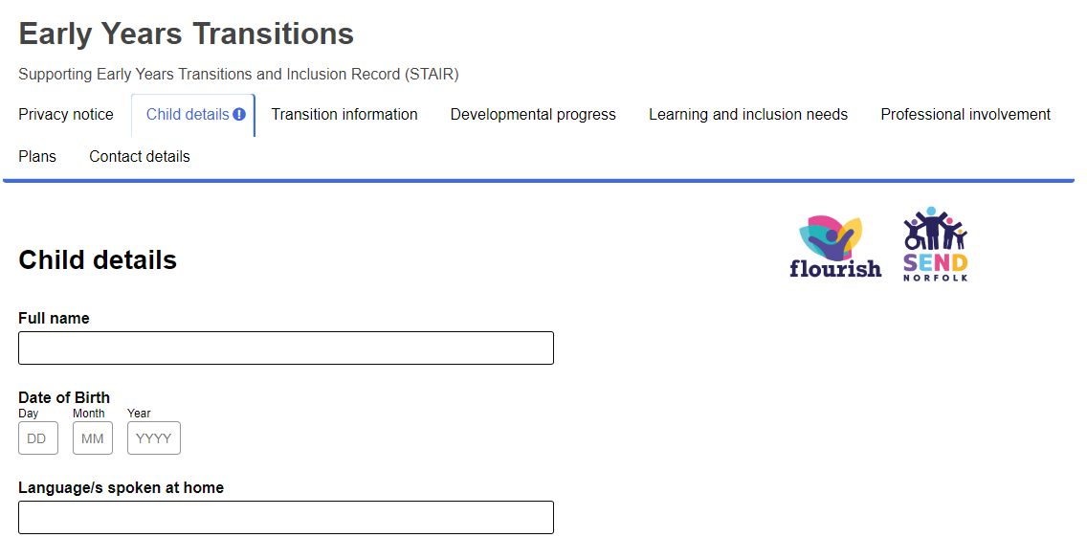
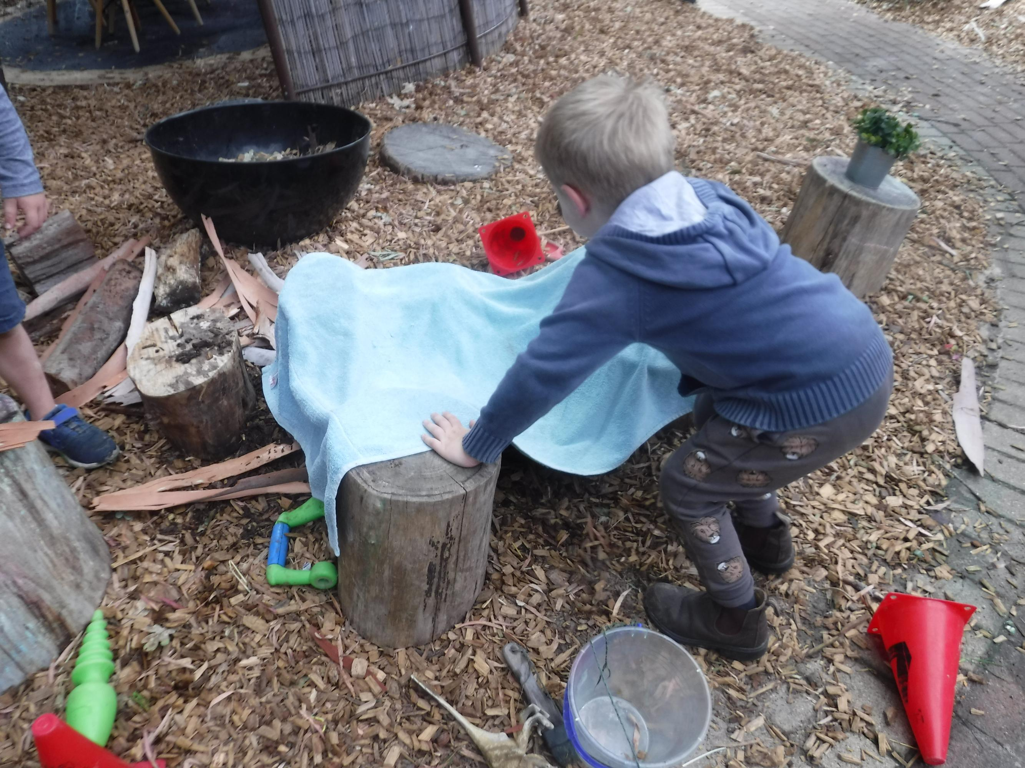
My changes and new beginnings
My family and I understand and prepare for the choices I can make about changes in my life, for example, changing schools, choosing a hobby, moving house, choosing and making new friends
Developments and successes
Health Check 14th Birthday card
Really love this document as it is based around the child…we love it!
Early Years Supporting transition and inclusion record transition (STAIR) document
Notes:
Steph

Slide 19


My changes and new beginnings - priorities and actions ​
Priorities
My family and I are given the information we need to understand and be involved in supporting my next steps to be successful ​
My family and I trust everyone involved in planning and supporting my next steps so I can achieve what is best for me
My family and I can share our views about decisions in my life and feel confident that these are listened to​
I have options so I can choose the next steps that are right for me
Action
Improve transition guides and communicate them widely so that transitions are consistently well planned
Notes:
Maxine

Slide 20
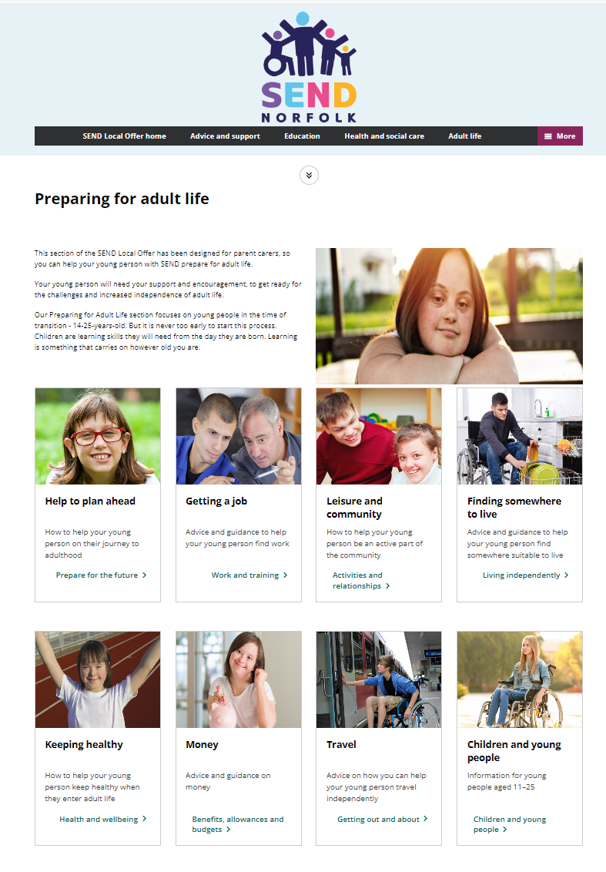
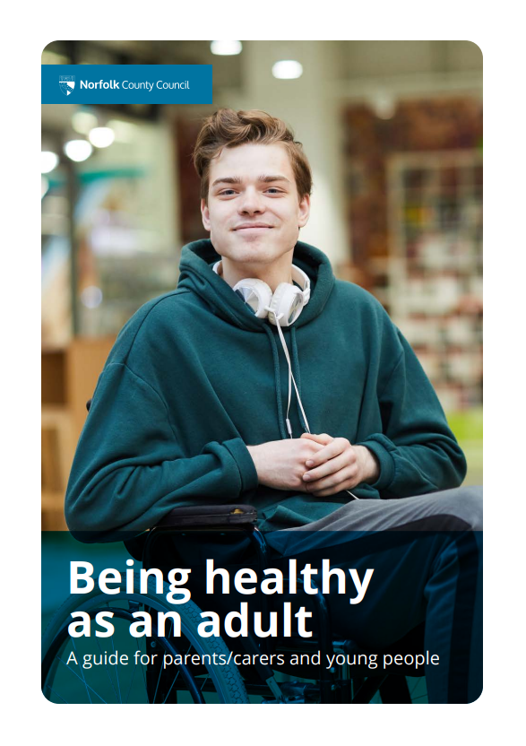
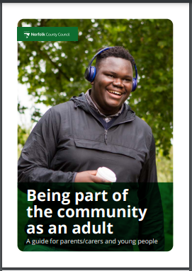
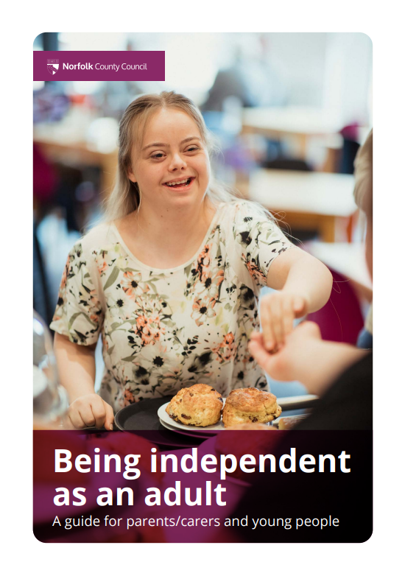
My adult life
I feel excited about enjoying my adult life, knowing I am being supported from the earliest years
Developments and successes
Notes:
Steph

Slide 21
My adult life - priorities and actions ​
Priorities
I know what good physical and mental health feels like for me. I know when I need help and where to get it from
I have all the information and help I need to make choices
I have lots of opportunities to develop the knowledge, skills and values I need to be happy, healthy and safe as an adult
I have family, friends and places that I know where I am valued and supported
I have opportunities to work
Action
Improve transition guides and guidance for young people moving into adult services to ensure this transition is consistently well-planned
Notes:
Maxine

Slide 22
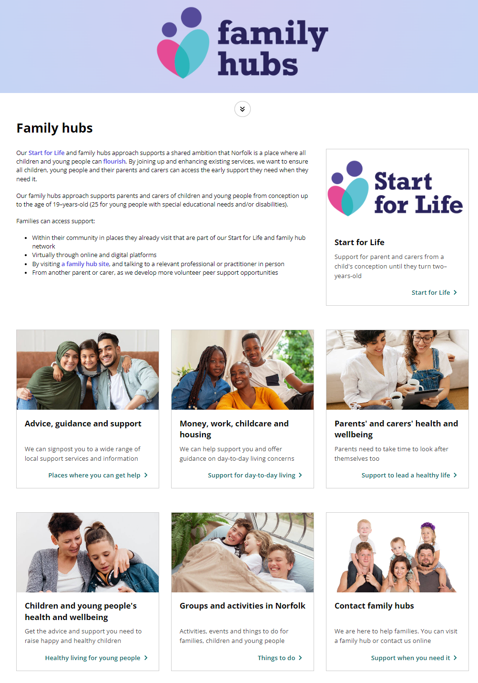
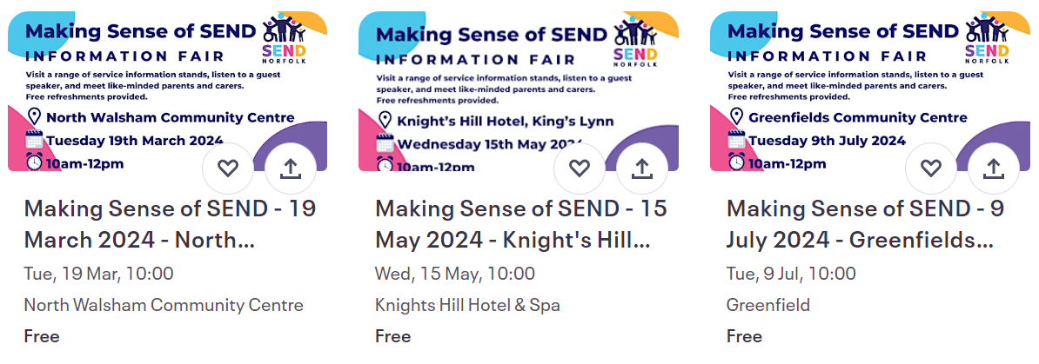
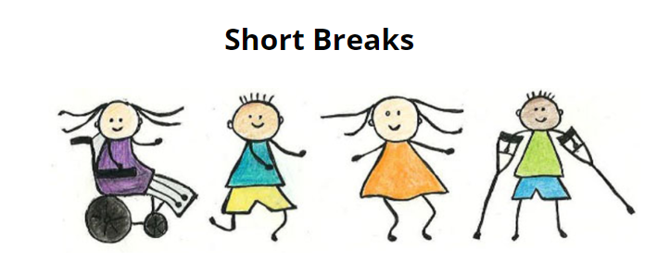
My family is supported
My family gets the help they need and feels supported
Developments and successes
Notes:
Steph

Slide 23
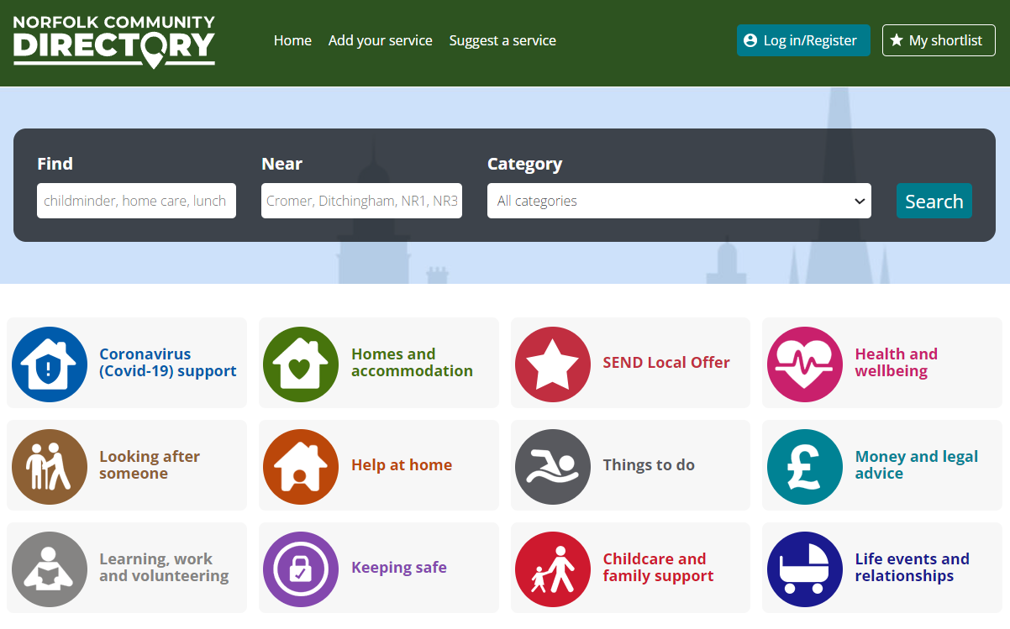

My family is supported - priorities and actions ​
Priorities
My family can talk to a professional and are confident they will help them feel listened to and supported
My family knows how to get information, advice and support
Information, advice and support is made available and provided in a way that meets the needs of everyone
My family knows how to get information, advice and support
My family, friends and local community are provided with information, help and support
Action
Improve the way that information is made available for families
Notes:
Maxine

Slide 24

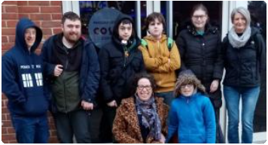
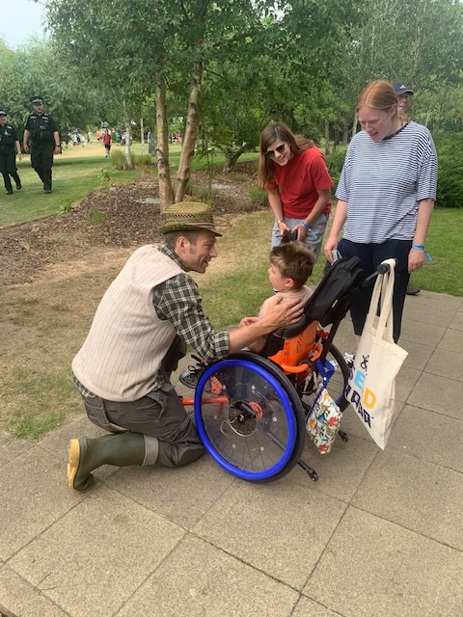
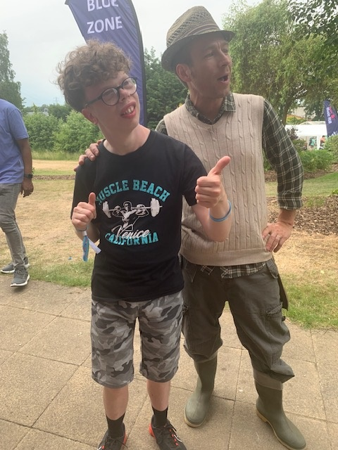
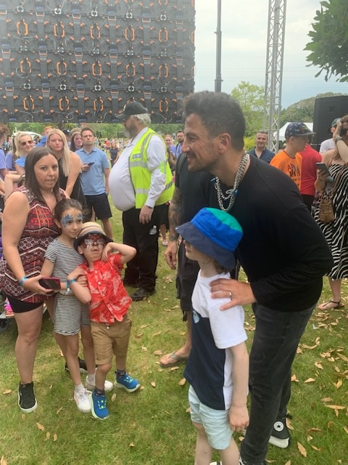
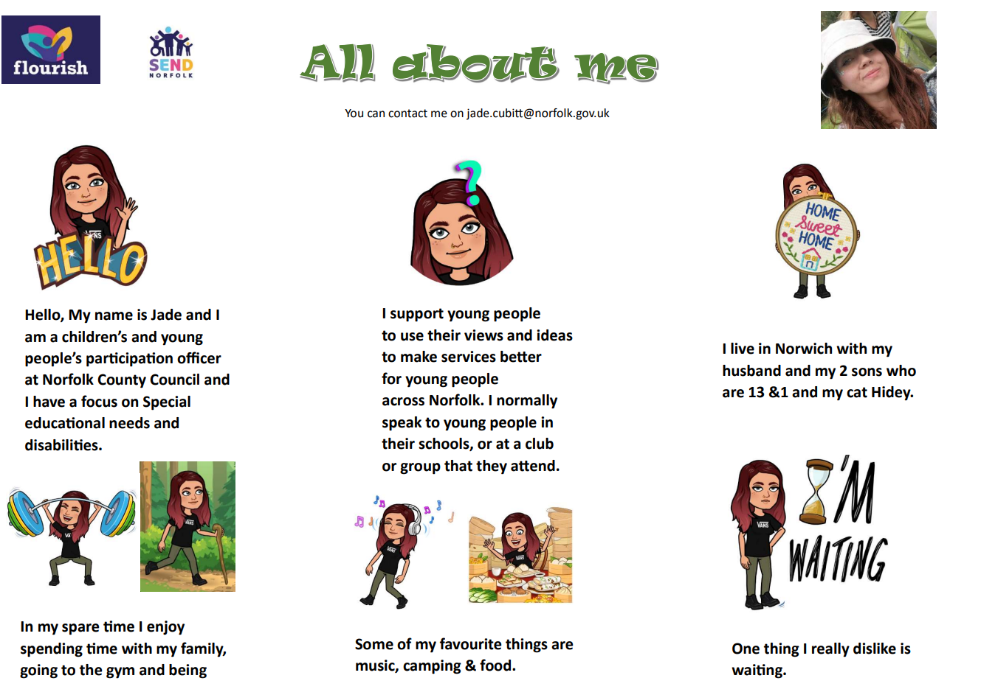
My friends and activities
My family, friends and I can take part in a range of activities that we enjoy independently and together
SEND Youth Forum
Developments and successes
New SEND Participation Officers
Notes:
Steph

Slide 25


My friends and activities - priorities and actions ​
Priorities
My family and I know where to find out about opportunities available to us
I am supported to have the confidence and motivation to take advantage of the activities and experiences that interest me the most
I can develop friendships through a choice of activities that I can enjoy independently without worrying about bullying
I can take part in activities and experiences of my choice and develop new skills
Action
To increase opportunities for children and young people with SEND to engage with activities in their community
Notes:
Maxine

Slide 26

Thoughts, questions and comments
Thank you!
Notes:
Michael

